Slide 1
Hardware design basics
as viewed by a software person
(part 2)
This presentation (along with the sample code) lives on github: https://github.com/quarck/vhdl_intro

Slide 2
VHDL – a bit more formal introduction
Strictly typed language
Types of VHDL objects:
constant
variable
signal
file (we would ignore this one)
Object definition:
<Object type> <name> : <data type> [:= Initial value];

Slide 3
VHDL: example object definitions
constant MATH_PI : real := 3.1415927;
variable ctr : integer :=0;
signal Q : bit := ‘0’;
Note: signal assignment is different between variables and signals (on purpose, we would cover it later):
Q <= not Q;
ctr := ctr + 1;

Slide 4
VHDL – a bit more formal: basic types
type bit is (‘0’, ‘1’);
type boolean is (false, true);
type character is (NUL, SOH, … ‘ ’, ‘!’, … ‘A’, ‘B’, … ‘a’, ‘b’, …);
type integer is range -2.147.483.647 to 2.147.483.647; -- particular implementations may extend this range
type real is range -1.0e38 to 1.0e38; -- particular implementations may extend this range

Slide 5
VHDL – a bit more formal: basic types
subtype natural is integer range 0 to integer'high;
subtype positive is integer range 1 to integer'high;
type string is array (positive range <>) of character;
type bit_vector is array (natural range <>) of bit;

Slide 6
VHDL – a bit more formal: types
std_logic is a library defined type:
type std_logic is (
‘U’, -- Uninitialized
‘X’, -- Forcing unknown
‘0’, -- Forcing 0
‘1’, -- Forcing 1
‘Z’, -- High impedance
‘W’, -- Weak unknown
‘L’, -- Weak 0
‘H’, -- Weak 1
‘-’ -- Don’t care
};

Slide 7
VHDL – a bit more formal: physical types
By example, system time type:
type time is range 0 to 1e20
units
fs;
ps = 1000 fs;
ns = 1000 ps;
us = 1000 ns;
ms = 1000 us;
sec = 1000 ms;
min = 60 sec;
hr = 60 min;
end units time;

Slide 8
VHDL: arrays, example
type ram_t is array (0 to 255)
of std_logic_vector(7 downto 0);
signal ram : ram_t :=
(others => (others => '0’));
type bit_vector is array (natural range <>)
of bit;

Slide 9
VHDL: arrays, example
type ram_t is array (0 to 255) of std_logic_vector(7 downto 0);
signal ram : ram_t := (others => (others => '0'));
-- Xilinx-specific: can be also peppered with:
attribute ram_style: string;
attribute ram_style of ram : signal is "distributed";
-- or
attribute ram_style of ram : signal is “block";
-- or
attribute ram_style of ram : signal is “auto";

Slide 10
VHDL: records (structs), example
type t_TO_FIFO is record
wr_en : std_logic;
wr_data : std_logic_vector(7 downto 0);
rd_en : std_logic;
end record t_TO_FIFO;

Slide 11
VHDL: operations: relational
Operation | Comment
=
/= | Not equal
<
<=
>
>=

Slide 12
VHDL: operations: logic
Operation | Comment
and
or
nand | a nand b = not (a and b)
nor | a nor b = not (a or b)
xor | exclusive or
not

Slide 13
VHDL: operations: Arithmetic
Operation | Comment
+
-
*
/
** | Power
mod
rem
abs

Slide 14
VHDL: operations: Concatenation
Operation | Comment
&
signal a : std_logic_vector (7 downto 0) := “00000000”;
signal b : std_logic_vector (8 downto 0);
…
b <= ‘0’ & a; -- makes 8-bit signal into 9-bit

Slide 15
VHDL: design units
Entity
Architecture
Package
Configuration (we would skip this one for now)

Slide 16
VHDL: entity, formal syntax
entity <id> is
[<generic>];
[<ports>];
[<declarations>];
[begin <sentences>];
end [entity] [<id>];

Slide 17
VHDL: entity - example
entity MUX21 is
port(
A : in bit;
B : in bit;
Ctrl : in bit;
Z : out bit;
end MUX21;

Slide 18
VHDL: entity, example with generics
entity MUX21n is
generic( n : integer := 2);
port( A : in bit_vector(n-1 downto 0);
B : in bit_vector(n-1 downto 0);
Ctrl : in bit;
Z : out bit_vector(n-1 downto 0));
end MUX21;

Slide 19
VHDL: architecture, formal syntax
architecture <id> of <id_entity> is
[<declarations>];
begin
<concurrent sentences>;
end [architecture] [<id>];

Slide 20
VHDL: architecture, code example:
architecture Behaviour of MUX21n is
begin
process(A, B, Ctrl)
begin
if Ctrl = ‘0’ then
Z <= A;
else
Z <= B;
end if;
end process;
end Behaviour;

Slide 21
VHDL: package
Declaration:
package <identifier>
[<declarations>];
end [package] [<identifier>]
Body:
package body <identifier>
[<Assignments and Detailed definitions>];
end [package body] [<identifier>]

Slide 22
VHDL: package usage
Usage:
use <library>.<package name>.[<identifier> | all];
Example standard packages:
std_logic_1164
std_logic_arith
Used as follows:
library ieee;
use ieee.std_logic_1164.all;
use ieee.std_logic_arith.all;

Slide 23
VHDL: concurrent & sequential statements
Two types of code statemtns:
Concurrent
Sequential
All the VHDL code is concurrent by default
Unless it resides inside the “process” statement (also applies to “procedure” and “function” declarations)
Anything inside “process” statement is sequential

Slide 24
VHDL: concurrent statements
All the lines of code are “executed” simultaneously
Example:
signal a : std_logic := ‘1’;
signal b : std_logic := ‘0’;
begin
-- code below swaps bit values between a and b
a <= b when rising_edge(clk);
b <= a when rising_edge(clk);
end …;

Slide 25
VHDL: sequential statements
Code inside the “process” statement behaves as if it was just a regular software thread, “executing” line by line
Each “process” is executing in parallel with other processes
Synthesis tool would analyse the behaviour and produce the netlist that implements the required behaviour
A lot of sequential code statements cannot be synthesised, but can be used in testbenches, for example:
wait for 20ns;

Slide 26
VHDL: process (sequential statements):
Syntax:
[label:]
process [(<sensitivity list>)]
begin
<sequential sentences>
[<wait statements>;]
end process;
Either sensitivity list or at least one wait statement must be present.

Slide 27
VHDL: process, sensitivity list:
Sequential statements inside “process” block are re-run each time any signal in the sensitivity list changes its value
(Process statement is executed once unconditionally at “start”)
Example:
process (clk, x)
begin
if rising_edge(clk) then
z <= x;
end if;
end process;

Slide 28
VHDL: process, wait statement:
“Wait” statement suspends execution of the process until the wait condition is met
Can have simply a list of signals, in such case it is an equivalent to a sensitivity list Example:
process
begin
if rising_edge(clk) then
z <= x;
end if;
wait on clk, x;
end process;

Slide 29
VHDL: process, wait statement:
Formal syntax:
[label:] wait [on <signal> {, ...}]
[until <boolean_expresion>]
[for <time_expresion>];
Examples:
wait on clk, x;
wait for 10 ns;
wait until clk = ‘1’;
wait; -- “terminates” the process

Slide 30
VHDL: process, signals vs variables
Both “signals” and “variables” can be used inside the process statement
Variable assignment has an immediate effect
Signal assignment only “applies” when process is suspended

Slide 31
VHDL: process, signals vs variables, example:
process
variable a : std_logic = ‘0’;
signal b : std_logic = ‘1’;
begin
if rising_edge(clk) then
a := y; -- value of ‘a’ is changed immediately
b <= y; -- value of ‘b’ is ‘cached’
if x = ‘1’ then
a := z; -- value of ‘a’ is changed again
b <= z; -- ‘b’ is still cached
end if;
end if;
wait on (clk, x, y, z); -- here ‘b’ is finally applied
end process;

Slide 32
VHDL: process, signals vs variables
“signal” translates directly into a wire of flip-flop
“variable” gives some flexibility for the tool to analyse the behaviour and produce netlist that implements it, might as well get translated into the wire of flip-flop
“signal” can be viewed in the simulation waveform, while “variable” is usually not

Slide 33
VHDL: Variable assignment (process only)
[label:] <variable name> := <expression>;

Slide 34
VHDL: signal assignment
[label:] <signal_name> <= [delay_type] <expression> {after <delay>};
Can take quite complicated form, but these can be only used in testbenches:
A <= ‘0’, ‘1’ after 10 ns, ‘0’ after 15 ns, ‘1’ after 20 ns, ‘0’ after 30 ns, ‘1’ after 50 ns, ‘0’ after 70 ns;
B1 <= transport A after 10 ns;
B2 <= A after 10 ns;
B3 <= reject 5 ns A after 10 ns;
We would skip these ones

Slide 35
VHDL: conditional signal assignment
[<label>:] <signal> <= [delay_type]
{<expression|waveform> when <boolean expression> else}
< expression|waveform> [when <boolean expression>];
Example:
z <= a when s = “00” else
b when s = “11” else
unnafected when others;

Slide 36
VHDL: selective signal assignment
[<label>:]
with <expression> select
<signal> <= [delay_type]
{<expression|waveform> when <value>,}
<expression|waveform> when <value>;
Example:
with opcode select
res <= A + B when “00”,
A - B when “01”,
A and B when “10”,
A or B when “11”;
WOW! We’ve just implemented a very basic ALU (arithmetic logic unit) by accident!

Slide 37
VHDL: sequential stm, if-statements, formal syntax
[label:] if <condicion> then
<sentencias secuenciales>
{elsif <condicion> then
<sentencias secuenciales}
[else
<sentencias secuenciales>]
end if [label];

Slide 38
VHDL: sequential stm, case-statements, formal syntax
[label:] case <expresion> is
{when <value1> =>
<sequential sentences>;}
{when <value2> =>
<sequential sentences>;}
[when others =>
<sequential sentences>;]
end case [label];

Slide 39
VHDL: sequential stm, while loops
[label:] while <boolean_condition>
loop
<sequential sentences>
end loop [label];

Slide 40
VHDL: sequential stm, for loops
[label:] for <repetition_control>
loop
<sequential sentences>
end loop [label];
example:
for i in 1 to 10 loop
<statements>;
end loop example;
Loop variable should not be declared in advance, its lifetime is limited to the loop body
‘to’ can be changed to ‘downto’ for going down instead of going up.

Slide 41
VHDL: generate statements, ‘if’
Conditionally generate or skip a piece of definition, syntax:
<label>: if <condition>
generate
{<concurrent sentences>}
end generate;

Slide 42
VHDL: generate statements, ‘if’
Example:
if_32_bit: if n = 32
generate
a: ALU_32_bit port map (…);
end generate;
if_lt32_bit: if n < 32
generate
a: ALU_simple port map (…);
end generate;
-- to ensure we’ve covered all cases, let’s assert a bit:
assert n <= 32 report “Only 1-32 bits are supported”
severity failure;

Slide 43
VHDL: generate statements, “for”
Generates repeating blocks. Syntax:
<label>: for <range specification>
generate
{<concurrent sentences>}
end generate;

Slide 44
VHDL: generate statements, ‘for’
Example:
gen_adder: for i in 0 to 31
generate
adder: full_adder
port map(
a => a(i), b => b(i),
c_in => carry(i),
S => res(i),
c_out => carry(i + 1));
end generate;

Slide 45
VHDL: function, just a syntax
Declaration:
function <name> [(<parameters list>)] return <data_type>;
Definition:
function <name> [(<parameters list>)] return <data_type> is
{<declarative part>}
begin
{<sequential sentences>}
end [function] [<name>];
One or more “return [expression];” in here

Slide 46
VHDL: procedure, just a syntax
Declaration:
procedure <name> [(<parameters list>)];
Definition:
procedure <name> [(<parameters list>)] is
{<declarative part>}
begin
{<sequential sentences>}
end [procedure] [<name>];

Slide 47
FPGAs
First, let’s recall our state machines that we did already in the part 1

Slide 48
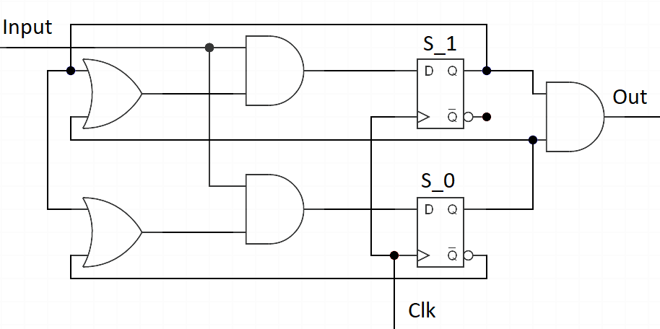
Sequence 111 detection FSM

Slide 49
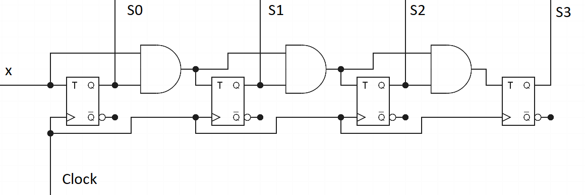
Sync counter FSM

Slide 50
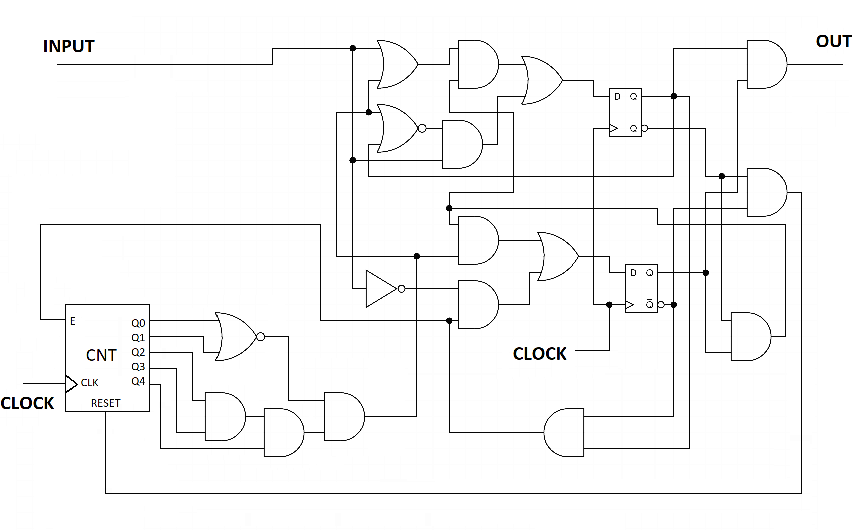
Ethernet preamble detection FSM

Slide 51
FPGAs..
Notice a pattern in all our state machines:
In consists of flip-flops paired with some combinatory circuit that defines the next state of the flip flop
Inputs into the combinatory circuit could be either current circuit’s input or the current value of the circuit flipflop(s) or both.
If we denote our combinatory circuits as black boxes, we can draw these state machines as (next slides):

Slide 52
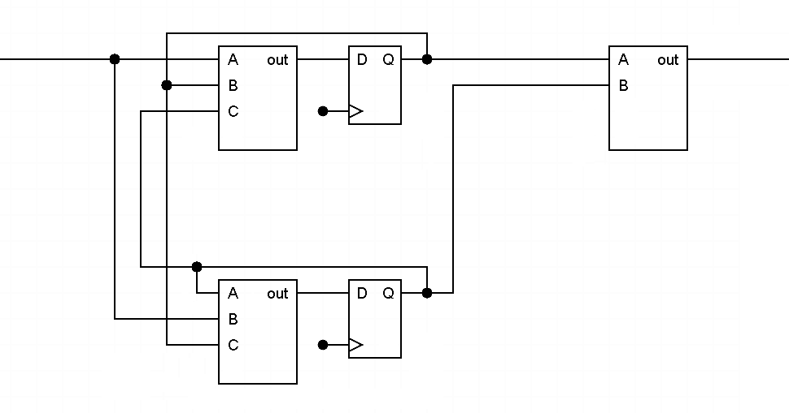
Sequence 111 detection, generalized

Slide 53
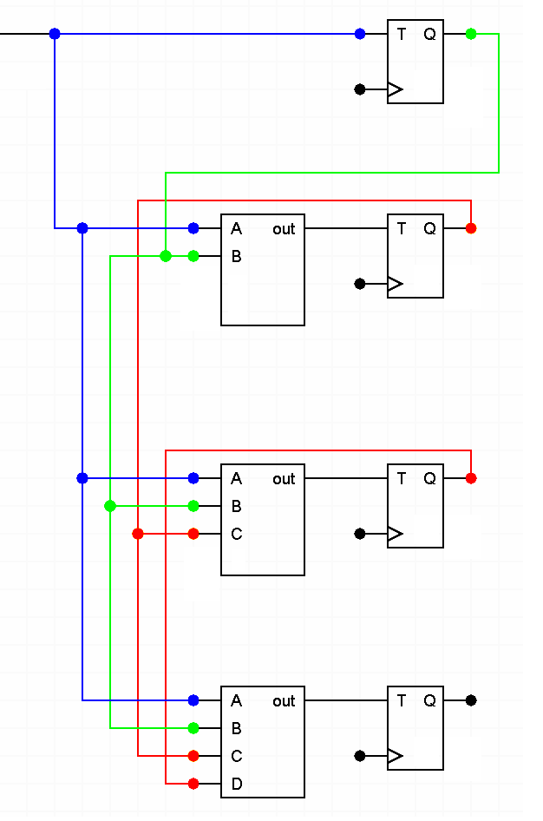
Sync counter:

Slide 54
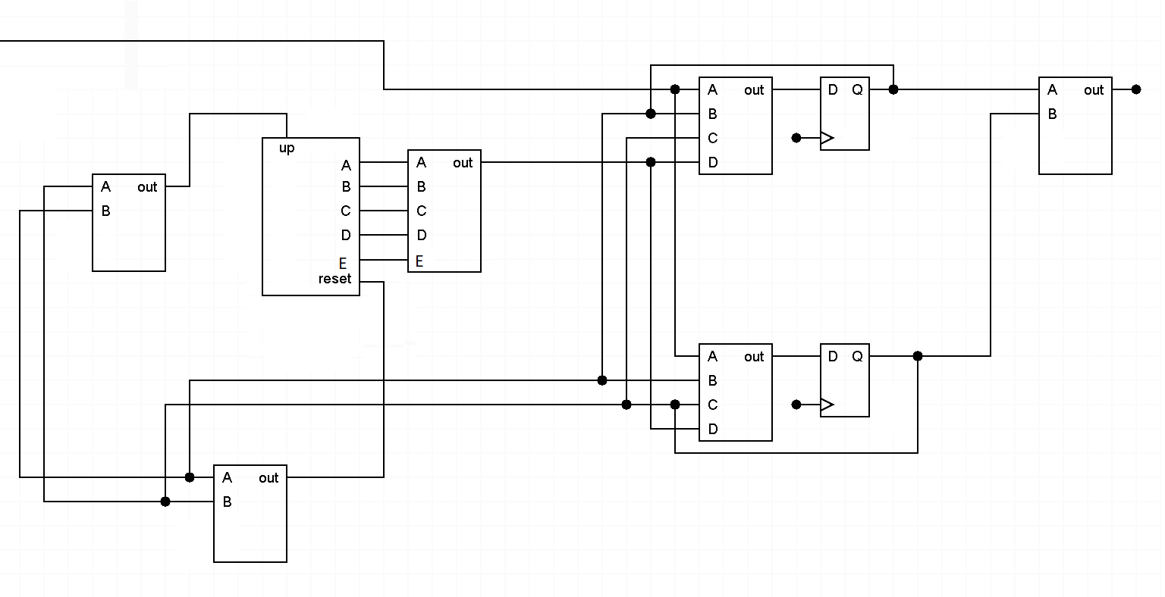
Ethernet preamble detection

Slide 55
FPGA
The pair of configurable logical function coupled with the flip-flop is basically an elementary construction of any FPGA, called “Logic Cell”
Configurable logical function is called LUT, implemented as a simple lookup table, can have between 3 and 6 inputs and 1 or several bits of output.
Logic Cell can be configured to bypass either LUT or flip-flop, acting as just a LUT on its own or as a D flip-flop
These CLBs are arranged into a huge arrays with configurable interconnects…
NOTE: FPGAs are not the only programmable logic devices that do exist, but the most capable ones

Slide 56
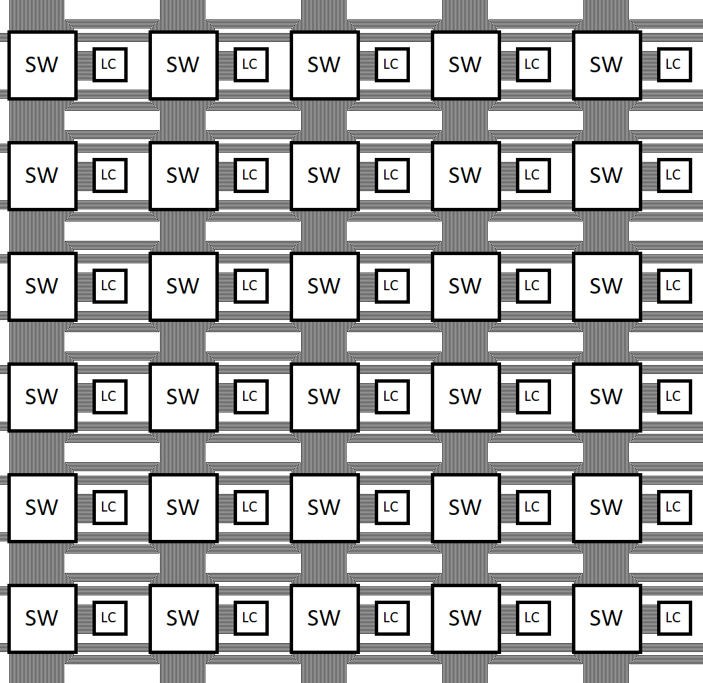
FPGA
A very generic FPGA architecture:
An ocean (sea, lake, puddle) logic cells (“fabric”) - LC
Connected by via switch matrixes – SW - to array of interconnects
Often has various “silicon” components as well –hardware modules designed for particular function (e.g.: memory controllers, multipliers, CPU cores, etc)

Slide 57
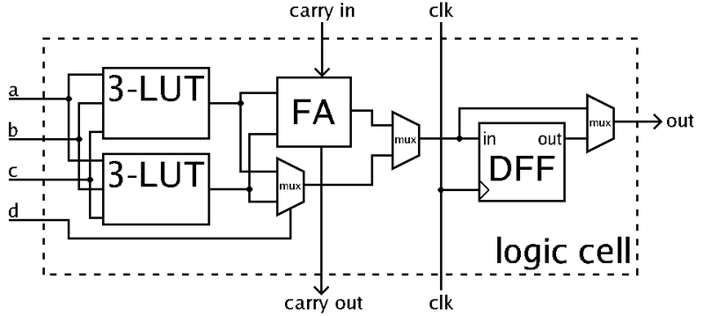
FPGA, example (simplified) logic cell

Slide 58
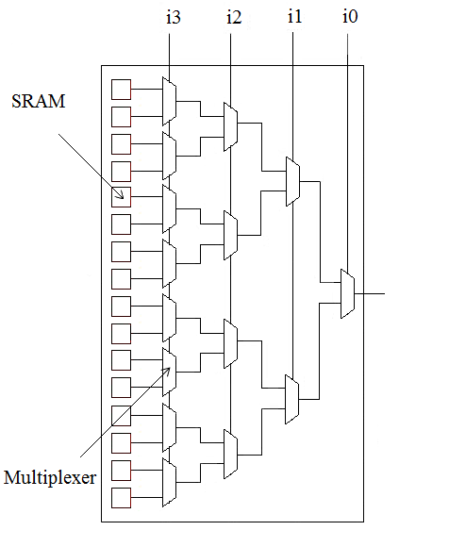
LUT structure

Slide 59
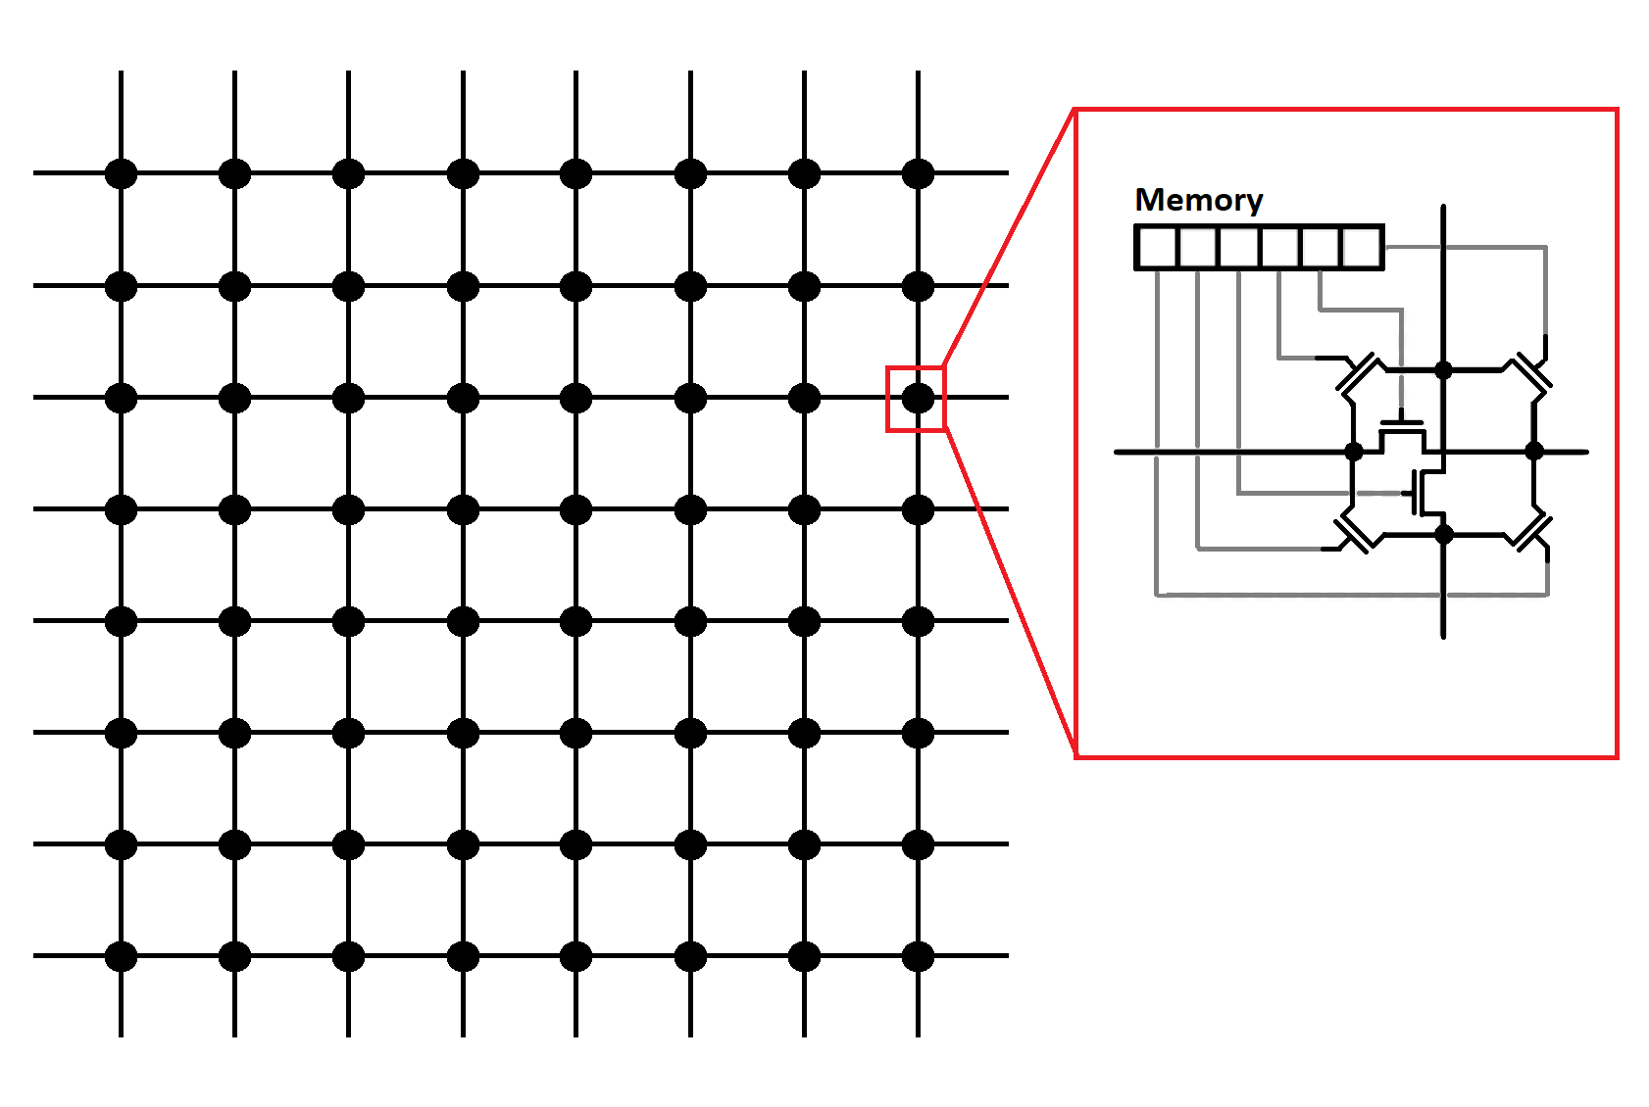
Switch matrix

Slide 60
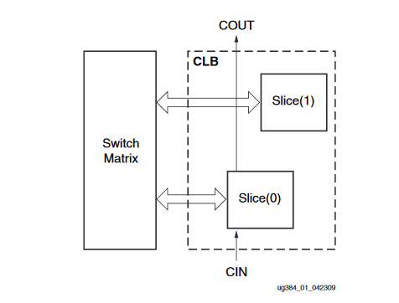
FPGA: LC in a real world, Spartan 6 example
Xilinx Spartan 6, logic cells are grouped into “Configurable Logic Blocks” – CLB
Each CLB contains two “slices”
Each slice is approximately identical and includes actual programmable logic – LUTs and FFs
There are three slice types on Spartan 6: SLICEM, SLICEL, SLICEX
Each type of slice contains a set of 6-input LUTs and 8 Flip-Flops
SLICEL and SLICEM also contain carry logic and wide multiplexers
SLCIEM also has Distributed RAM and Shift Registers on board.
Image, Source: https://www.xilinx.com/support/documentation/user_guides/ug384.pdf

Slide 61
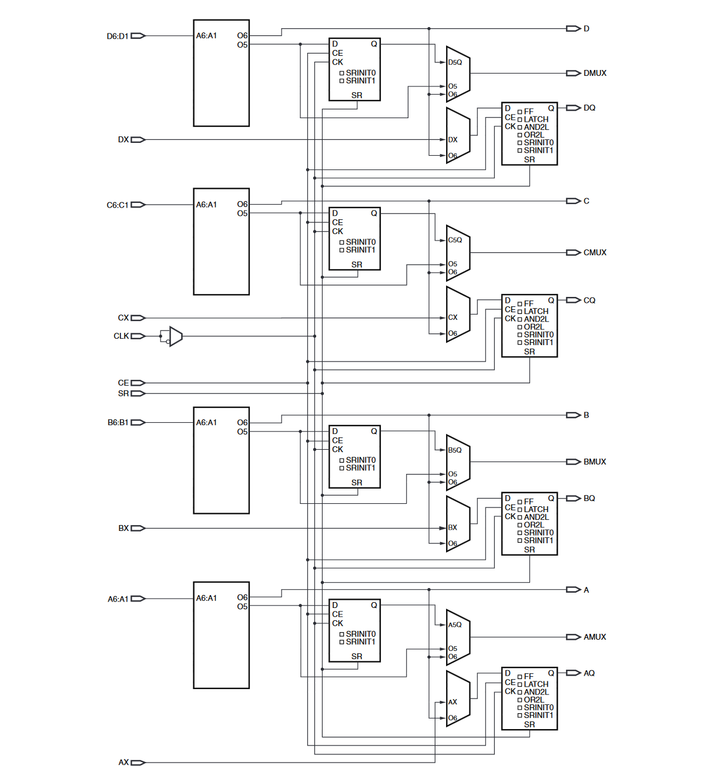
FPGA: Xilinx Spartan 6, SLICEX:
© Xilinx, Source: https://www.xilinx.com/support/documentation/user_guides/ug384.pdf

Slide 62
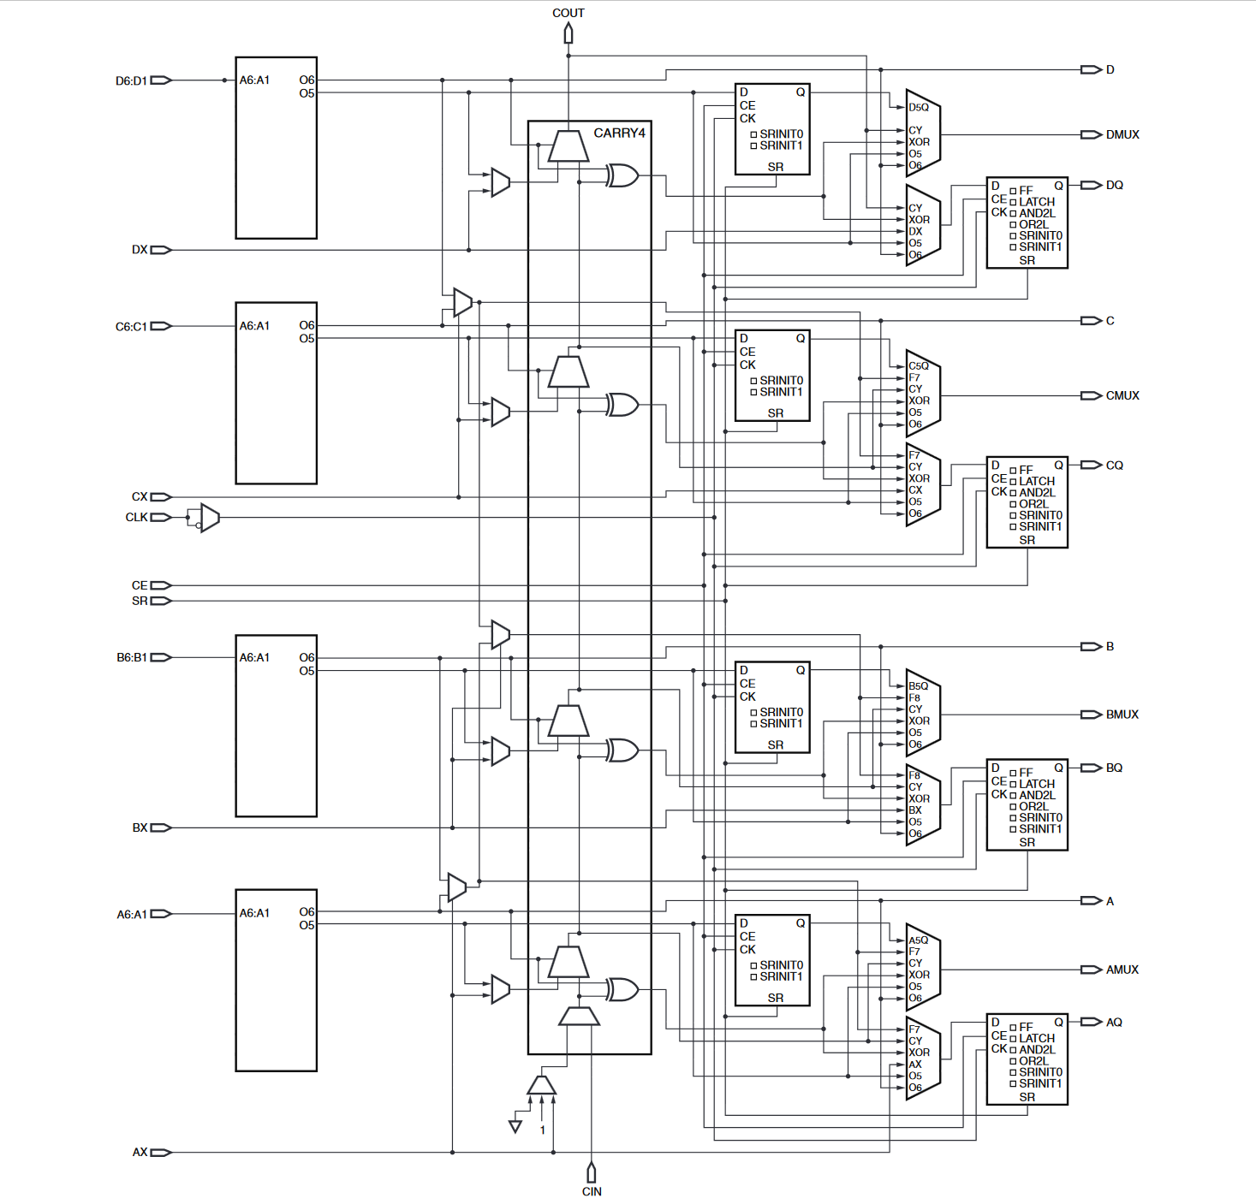
FPGA: Xilinx Spartan 6, SLICEL:
© Xilinx, Source: https://www.xilinx.com/support/documentation/user_guides/ug384.pdf

Slide 63
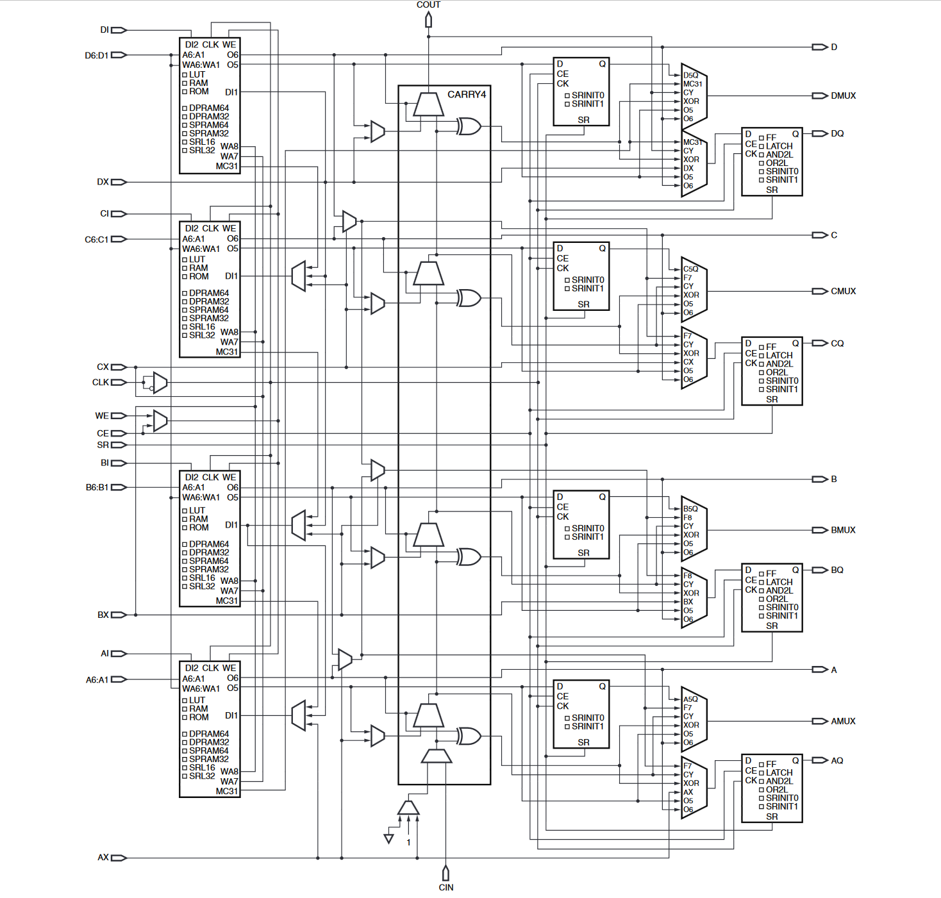
FPGA: Xilinx Spartan 6, SLICEM:
© Xilinx, Source: https://www.xilinx.com/support/documentation/user_guides/ug384.pdf

Slide 64
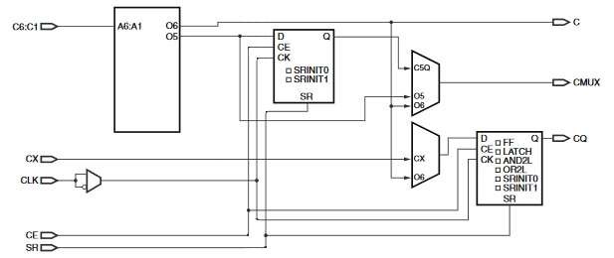
Spartan 6, ¼ of SLICEX, configuration variants
Two pre-programmable muxes (ignore the clock one), 6 combinations all together
Let’s review these combinations

Slide 65
Spartan 6, ¼ of SLICEX config., variant 1
One isolated FF with CX as input and CQ as output
LUT output O5 paired with FF into CMUX output
LUT output O6 connected directly to the slice output C

Slide 66
Spartan 6, ¼ of SLICEX config., variant 2
One isolated FF with CX as input and CQ as output
LUT output O6 connected directly to output C
LUT output O5 connected directly to output CMUX
Another FF is unused

Slide 67
Spartan 6, ¼ of SLICEX config., variant 3
One isolated FF with CX as input and CQ as output
LUT output O6 connected directly to both output C and CMUX
LUT output O5 is not used (perhaps this config. can help with routing in some cases)
Another FF is unused

Slide 68
Spartan 6, ¼ of SLICEX config., variant 4
Both LUT outputs are fed through FF I
LUT output O5 paired with FF into CMUX output
LUT output O6 paired with FF into CQ output
LUT output O6 also connected directly into C (may be unused)

Slide 69
Spartan 6, ¼ of SLICEX config., variant 5
LUT output O5 is now goes directly into CMUX
LUT output O6 paired with FF into CQ output
LUT output O6 also connected directly into C (may be unused)
One FF is unused

Slide 70
Spartan 6, ¼ of SLICEX config., variant 6
LUT output O6 paired with FF into CQ output
LUT output O6 also connected directly into C, and into CMUX
One FF is unused, as well as LUT O5
Not sure if this combination is used and if so - how

Slide 71
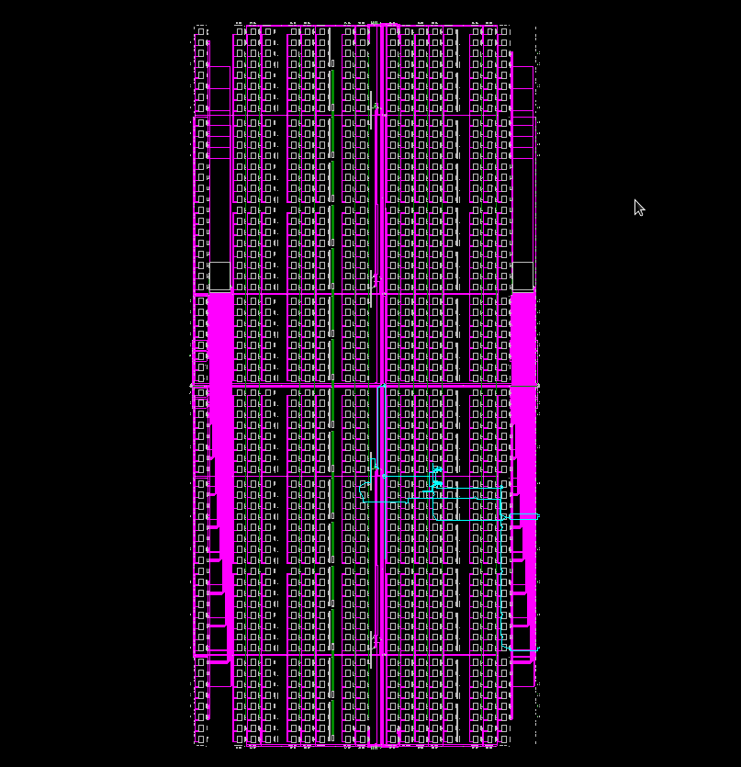
FPGA interconnects In the real world
This
Is Spartan! (Spartan 6, XC6SLX9,
1430 slices, 5720 luts, 11440 FFs)
Displaying:
Long lines (magenta)
Pin lines (green)
Switch matrixes (‘big’ squares)
Slices (tiny dots)
Local slice-level lines are not displayed

Slide 72
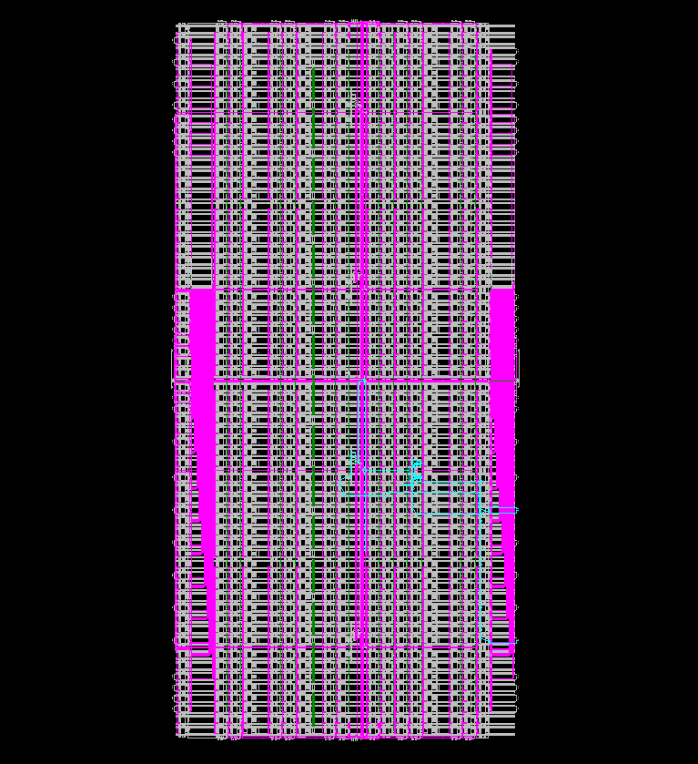
FPGA interconnects In the real world
This Is Spartan! (Spartan 6, XC6SLX9,
1430 slices, 5720 luts, 11440 FFs)
Displaying:
Long lines (magenta)
Pin lines (green)
Switch matrixes (‘big’ squares)
Slices (tiny dots)
Local slice-level lines (white mess)

Slide 73
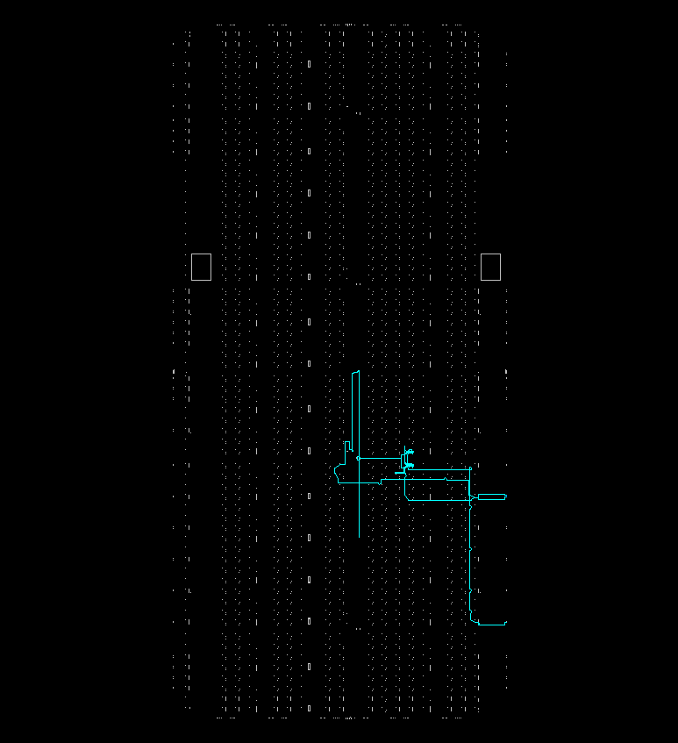
Spartan 6 XC6SLX9 structure, only slices
Only CLBS and the “eth preamble” bitstream routes are displayed
Key point: in the FPGA, most of the space is taken by the configurable routing / interconnects, and not by the logic cells

Slide 74
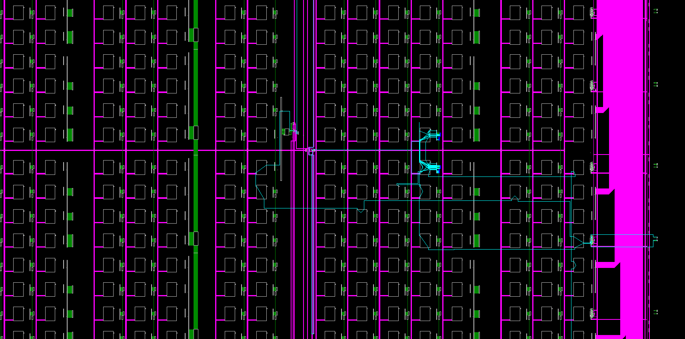
Spartan 6 XC6SLX9, zoom in, local lines not displayed
CLBs are too small to see here
Switch matrixes
Pin lines
Long lines

Slide 75
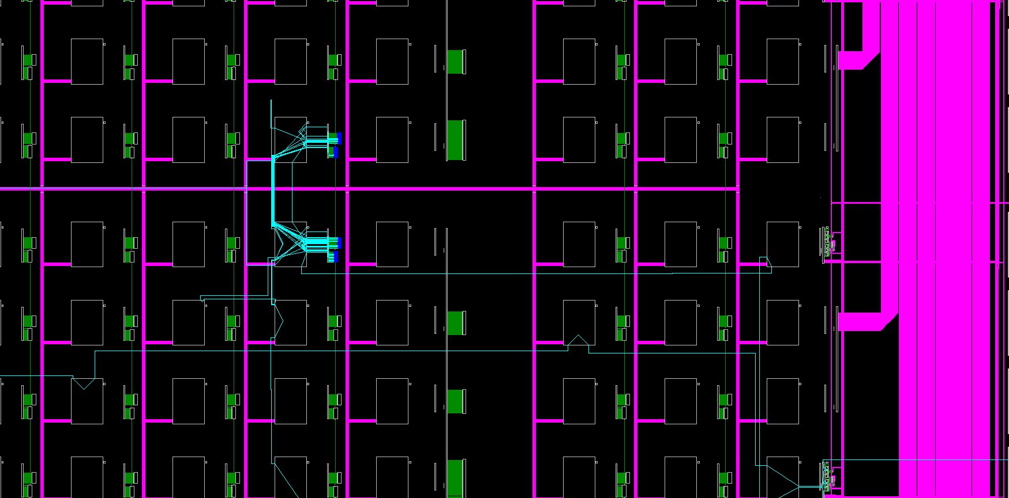
Spartan 6 XC6SLX9, further zoom in, no local lines
Slices (of CLB)
Switch matrixes

Slide 76
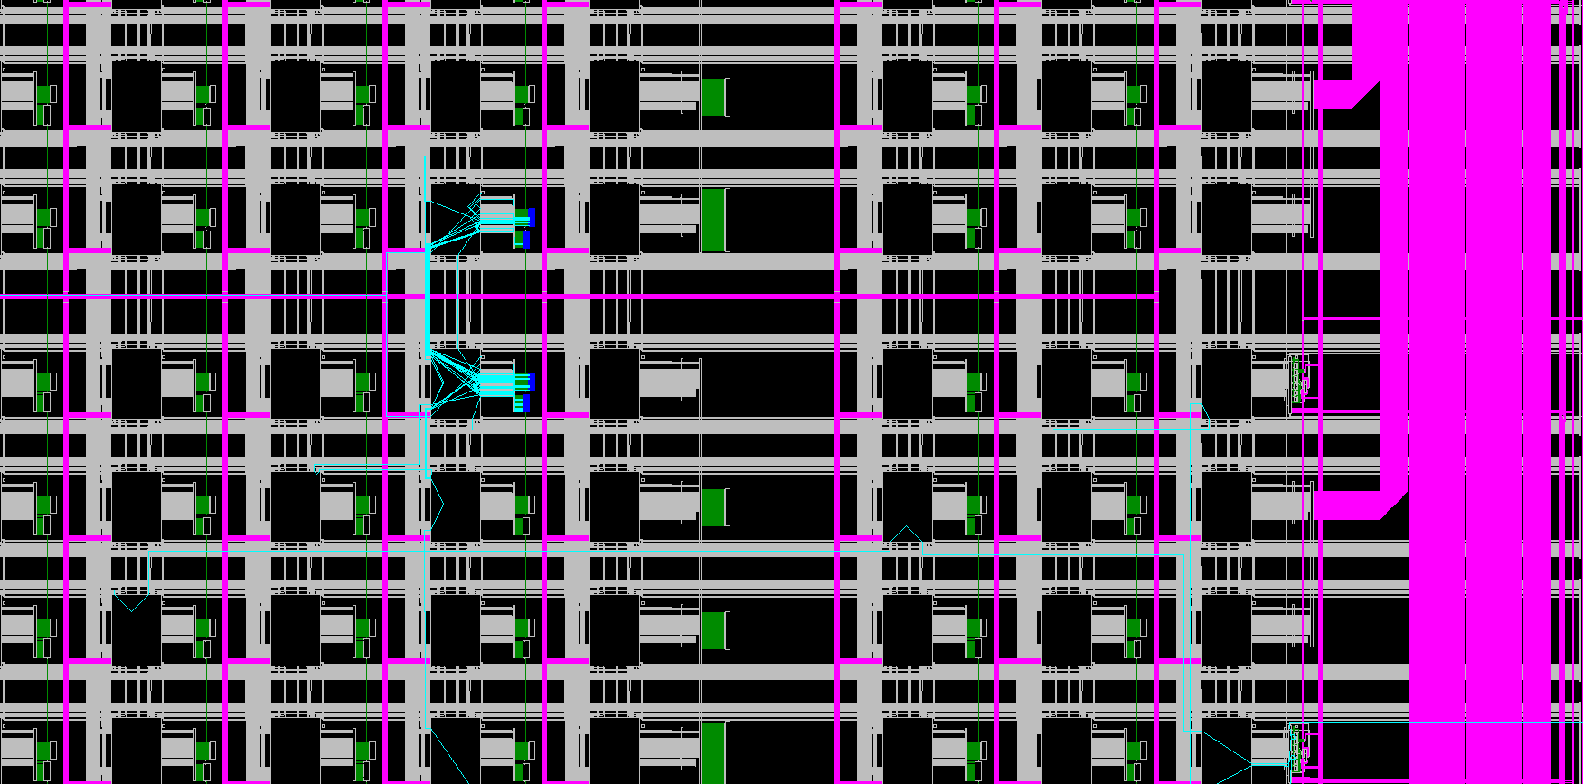
Spartan 6 XC6SLX9, local lines displayed

Slide 77
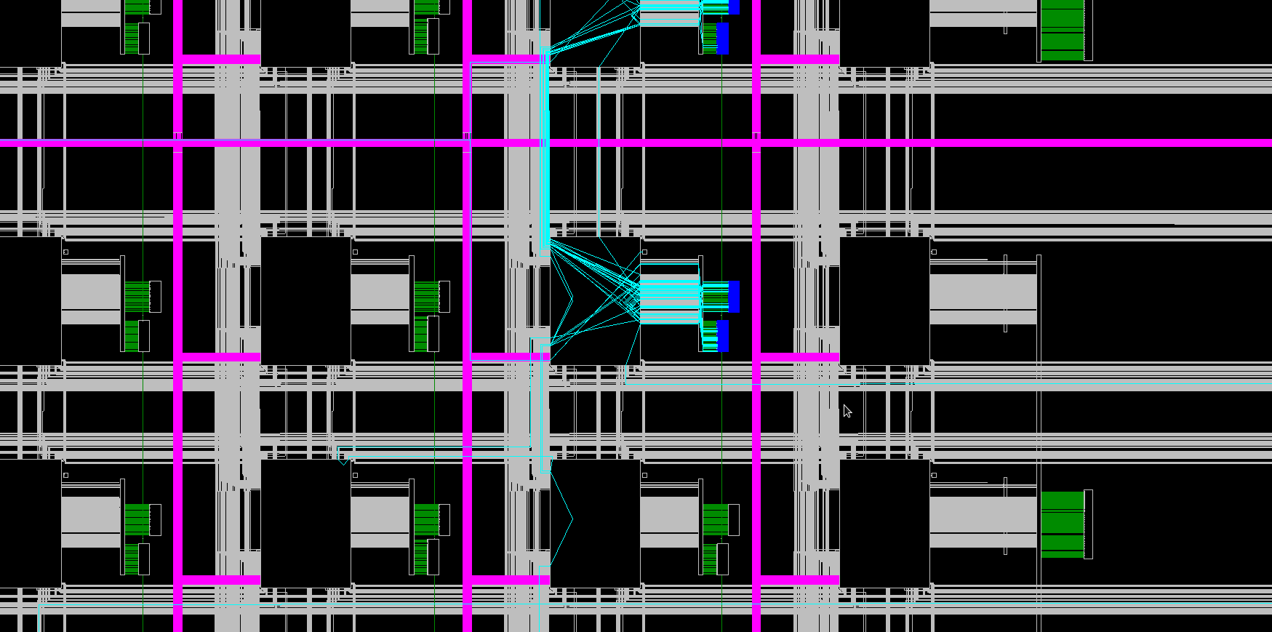
Spartan 6 XC6SLX9, further zoom in

Slide 78
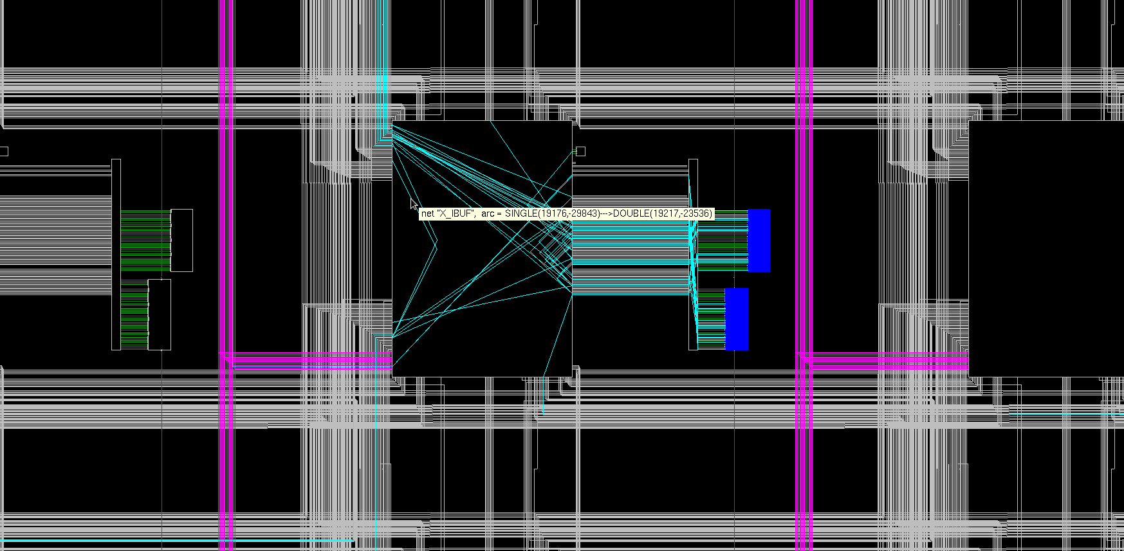
Spartan 6 XC6SLX9, further zoom in

Slide 79
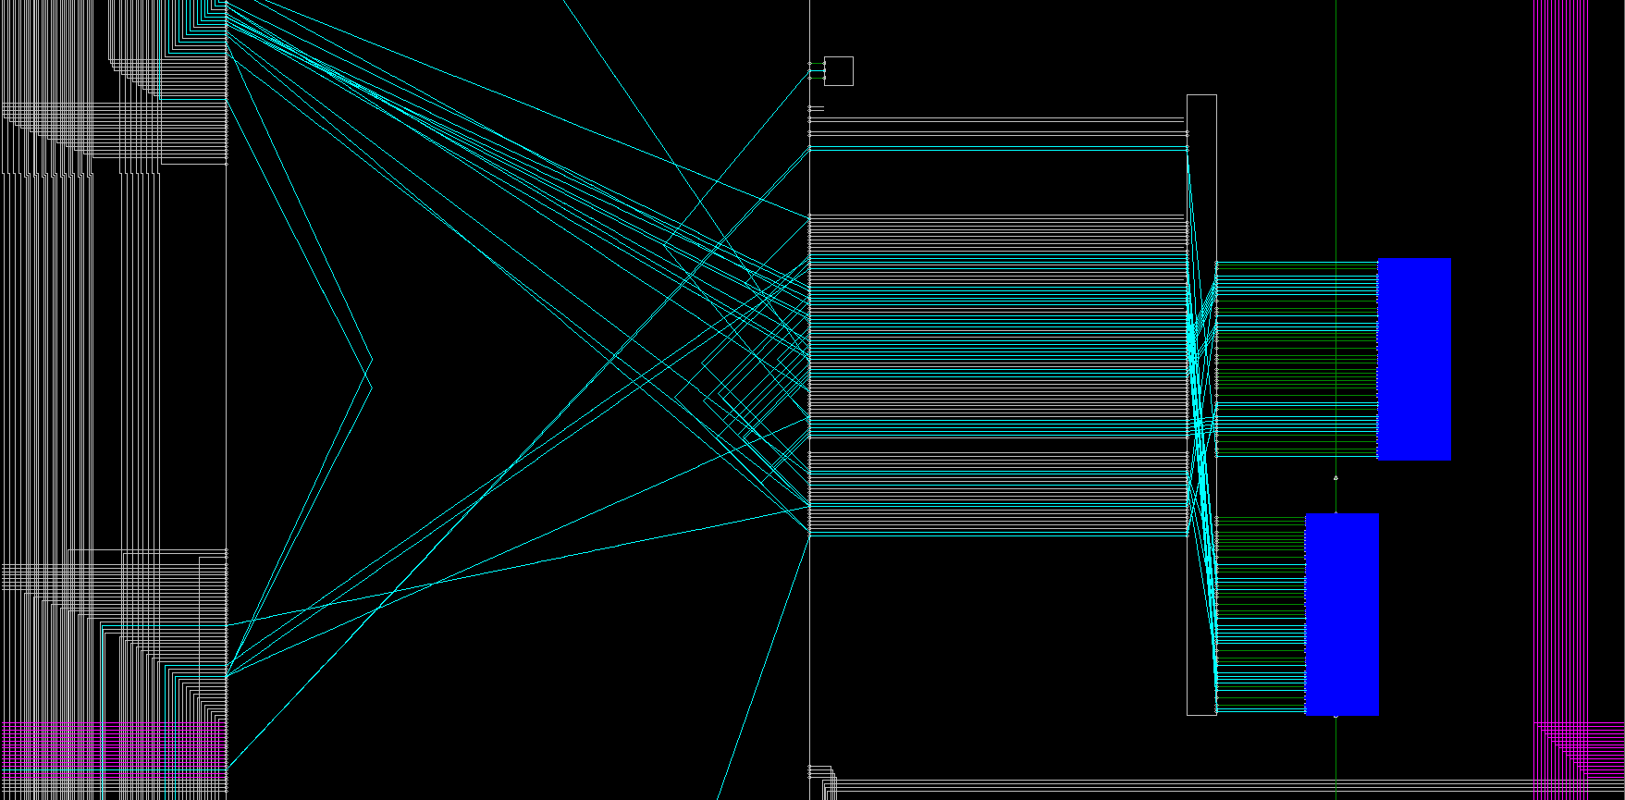
Spartan 6 XC6SLX9, at a max zoom
Two slices
Short Lines
Switch matrixes
Long Lines

Slide 80
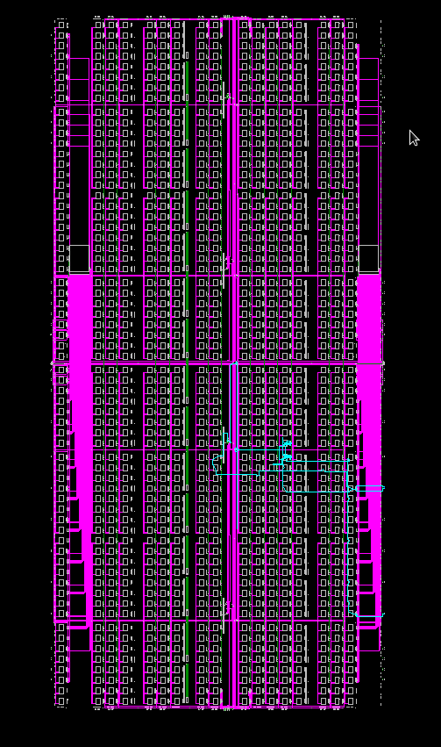
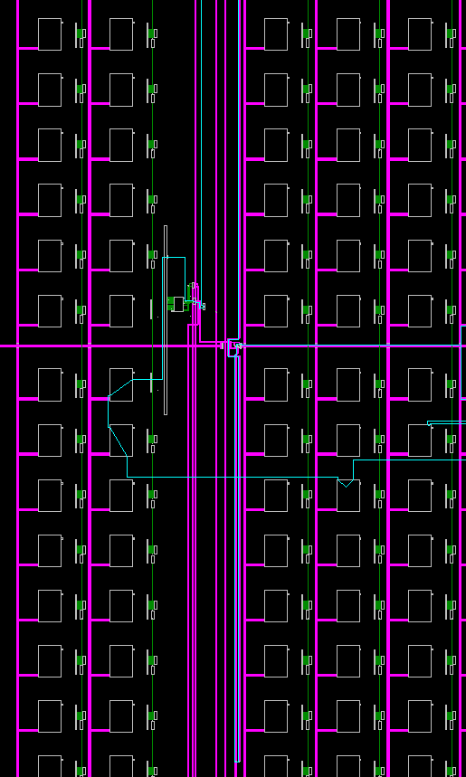
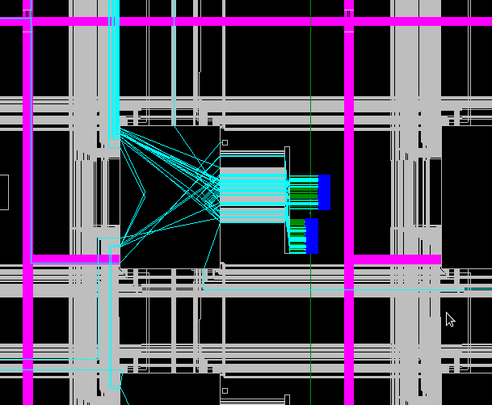
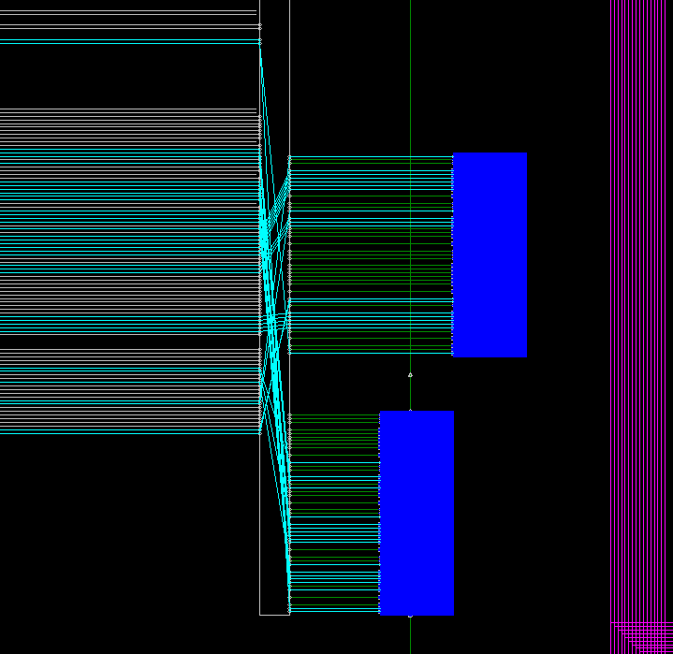

Slide 81
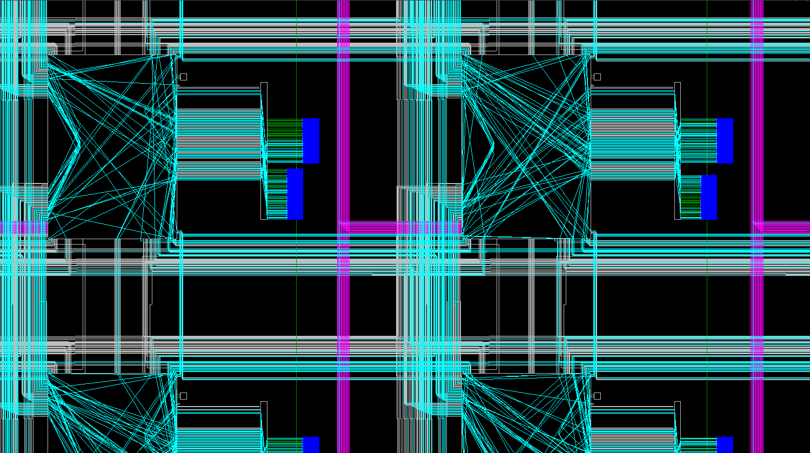

Slide 82
Time to reveal some magic?
“Final year project”

Slide 83
Simple 8-bit CPU
Let’s now try to design a very simple 8-bit central processing unit
Once we understand the basics would carry on with more advanced designs
Design is based on “Ahmes” 8-bit CPU core (link in the appendix C), but the actual design went far from the original design.

Slide 84
Our simple 8-bit CPU: architecture overview
von Neumann memory model – same memory for instructions and data (as opposite to Harvard commonly used in microcontrollers)
accumulator machine: single general purpose register called “accumulator”
Any math/logical/etc instruction implicitly refers to the accumulator as the first argument
Many “old days” computers were accumulator machines
ENIAC (20 accumulators operating in parallel)
PDP-8
MOS 6502
Intel 4004 and 8008 (modern day x86 has echoes of those days, for example “mul ecx” instruction would multiply registers “ecx” and “eax” and put result into pair of registers “eax” and “edx”)
Intel 8051 microcontroller (this family is still in production and new derived chips are being produced these days)
Thus, “accumulator machine” is not a sort of academic simplification of reality (aka “assume there no other bodies in the whole universe but two mass-points A and B”), but a production-used type of computers

Slide 85
Our simple 8-bit CPU: architecture overview, cont.
8-bit address and data buses – can address only 256 bytes (hey, we are only playing here)
Simple 8-bit ALU with no multiply / divide operations
One register: 8-bit accumulator
Flags register: 4 flags
n: negative – last ALU result was negative
z: zero – last ALU result was zero
c: carry – carry/borrow bit from the last ADD / SUB
v: overflow – last ALU resulted in a signed overflow
~50 instructions all together (15 instructions in the “first cut”)
All instructions are encoded as 2-bytes for simplicity, first byte identifies operation, second byte – an argument

Slide 86
Our simple 8-bit CPU: instruction set
Instruction | Action (C++-like syntax) | Comment
STA addr | mem[addr] = A | Store content of the accumulator into address ‘addr’
LDA addr | A = mem[addr] | Load accumulator with the content of memory address ‘addr’
LDC val | A = val | Load accumulator with direct value from the instruction

Slide 87
Our simple 8-bit CPU: instruction set
Instruction | Action (C++-like syntax) | Comment
ADD addr | A += mem[addr]
ADDC addr | A += mem[addr] + carry | Add with the carry that was set by the previous operation
SUB addr | A -= mem[addr]
SUBC addr | A -= mem[addr] + carry
SUBR addr | A = mem[addr] - A
SUBRC addr | A = mem[addr] - A - carry
NEG | A = - A | Treats A as signed, inverts sign (Not a distinct instruction, just another name for “SUBR_V 0”)

Slide 88
Our simple 8-bit CPU: instruction set
Instruction | Action (C++-like syntax) | Comment
ADD_V val | A += val
ADDC_V val | A += val + carry | Add with the carry that was set by the previous operation
SUB_V val | A -= val
SUBC_V val | A -= val + carry
SUBR_V val | A = val - A
SUBRC_V val | A = val - A - carry

Slide 89
Our simple 8-bit CPU: instruction set, cont.
Instruction | Action (C++-like syntax) | Comment
OR addr | A |= mem[addr]
AND addr | A &= mem[addr]
XOR addr | A ^= mem[addr]
NOT | A = !A | (Not a distinct instruction, just another name for “XOR_V 255”)
SHR addr | A = ((unsigned)A) >> mem[addr]
SHL addr | A = A << mem[addr]
SHAR addr | A = ((signed)A) >> mem[addr]
ROL addr | TL;DR; | Rotate left by mem[addr]
ROR addr | TL;DR; | Rotate right mem[addr]
RCL addr | TL;DR; | Rotate through carry left mem[addr]
RCR addr | TL;DR; | Rotate through carry right mem[addr]

Slide 90
Our simple 8-bit CPU: instruction set, cont.
Instruction | Action (C++-like syntax) | Comment
OR_V val | A |= val
AND_V val | A &= val
XOR_V val | A ^= val
SHR_V val | A = ((unsigned)A) >> val
SHL_V val | A = A << val
SHAR_V val | A = ((signed)A) >> val
ROL_V val | A = (A << val) | (A >> (8-val)) | Rotate left by val
ROR_V val | A = (A >> val) | (A << (8-val)) | Rotate right by val
RCL_V val | TL;DR; | Rotate through carry left by val
RCR_V val | TL;DR; | Rotate through carry right by val

Slide 91
Our simple 8-bit CPU: instruction set
Instruction | Action (C++-like syntax) | Comment
JMP addr | pc = addr | Jump to address addr
JMP_A arg | pc = A + addr | Jump to address A + addr
JN addr | if (n==1) { pc = addr } | Jump to address if negative result (n=1)
JP addr | if (n==0) { pc = addr } | Jump to address if positive result (n=0)
JNZ addr | if (z == 0) { pc = addr } | Jump to address if non zero result (n=0)
JZ addr | if (z == 1) { pc = addr } | Jump to address if zero result (n=1)
JNC addr | if (c == 0) { pc = addr } | Jump to address if carry is not set (c=0)
JC addr | if (c == 1) { pc = addr } | Jump to address if carry is set (c=1)
JNV addr | if (v == 0) { pc = addr } | Jump to address if no overflow (v=0)
JV addr | if (v == 1) { pc = addr } | Jump to address if overflow (v=1)

Slide 92
Our simple 8-bit CPU: instruction set
Instruction | Action (C++-like syntax) | Comment
IN port | A = io_port[port] | Read byte from I/O port
OUT port | io_port[port] = A | Write byte to I/O port
NOP | do {} while(false); | No operation, argument byte is unused
HLT | exit(0); | Full CPU stop until reset, argument byte is unused
SEVENSEGTRANSLATE |  | Performs table lookup to encode 4-bit number into 7-segment LCD display led configuration displaying given number

Slide 93
Our simple 8-bit CPU: instruction set
On a first iteration, we would implement even simpler CPU that can handle only the following sub-set of instructions:
STA / LDA / LDC
ADD / ADDC / SUB / SUBC
OR / AND / NOT
JMP / JNZ / JZ
HLT / NOP
Such minimalistic CPU isn’t very practical, but works well for generating Fibonacci Sequence, thus let’s call it “Fibonacci Processing Unit”- FibPU
Our VHDL code would also include memory module, so in fact we are building a SoC – System on a Chip

Slide 94
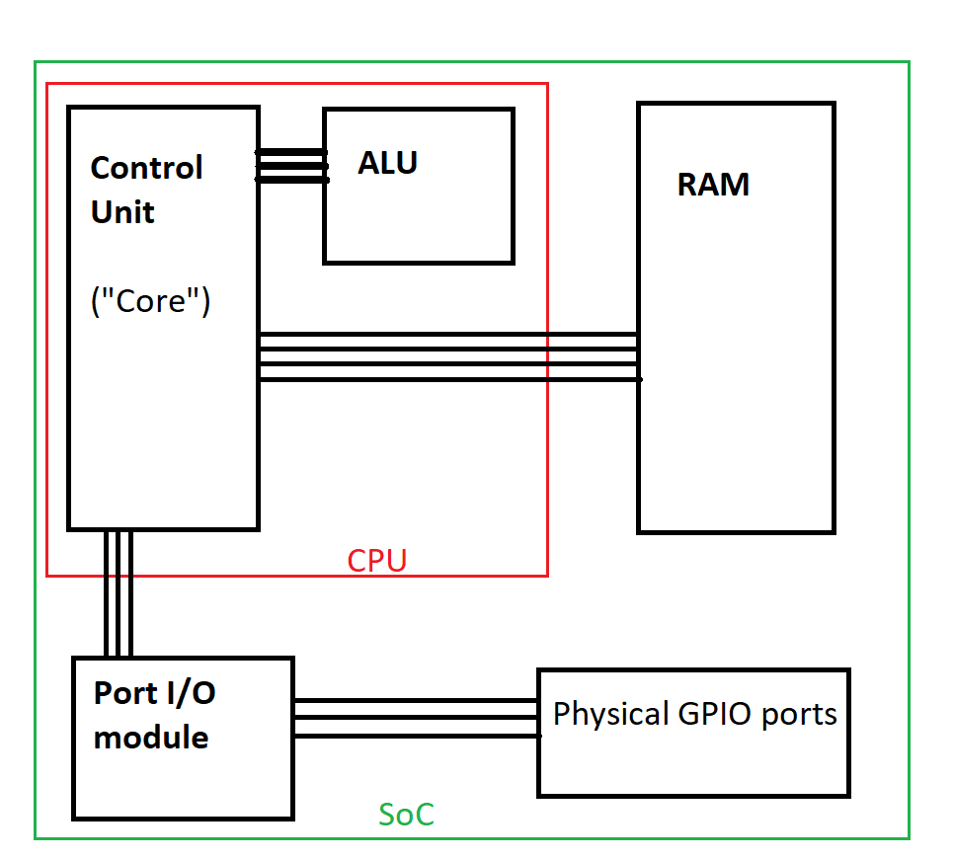
High-Level-Design

Slide 95
Instruction execution cycle
FETCH
DECODE
EXECUTE
STORE

Slide 96
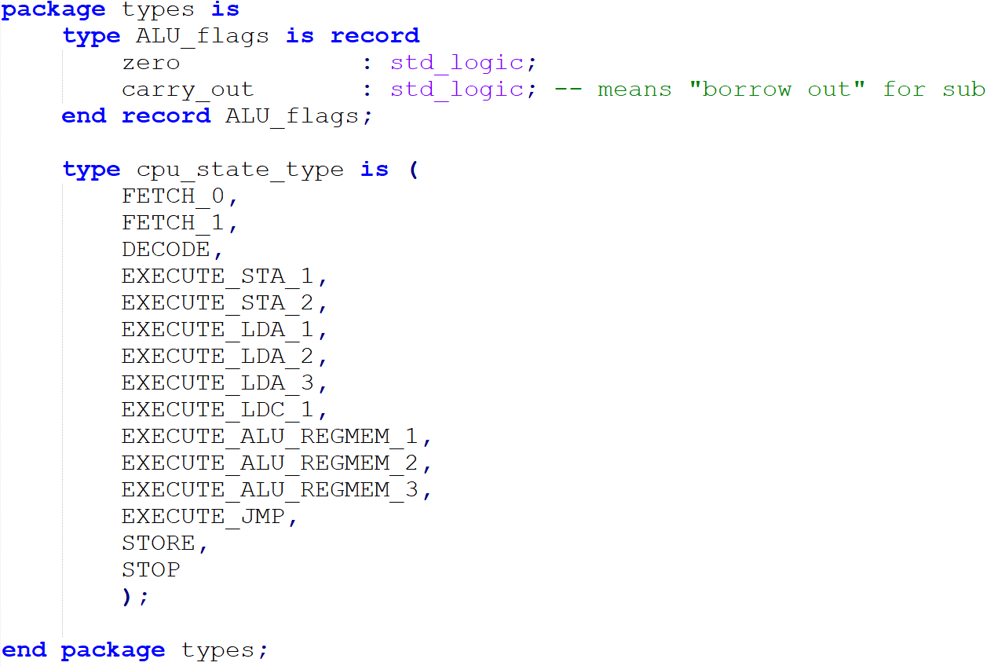
types.vhd

Slide 97
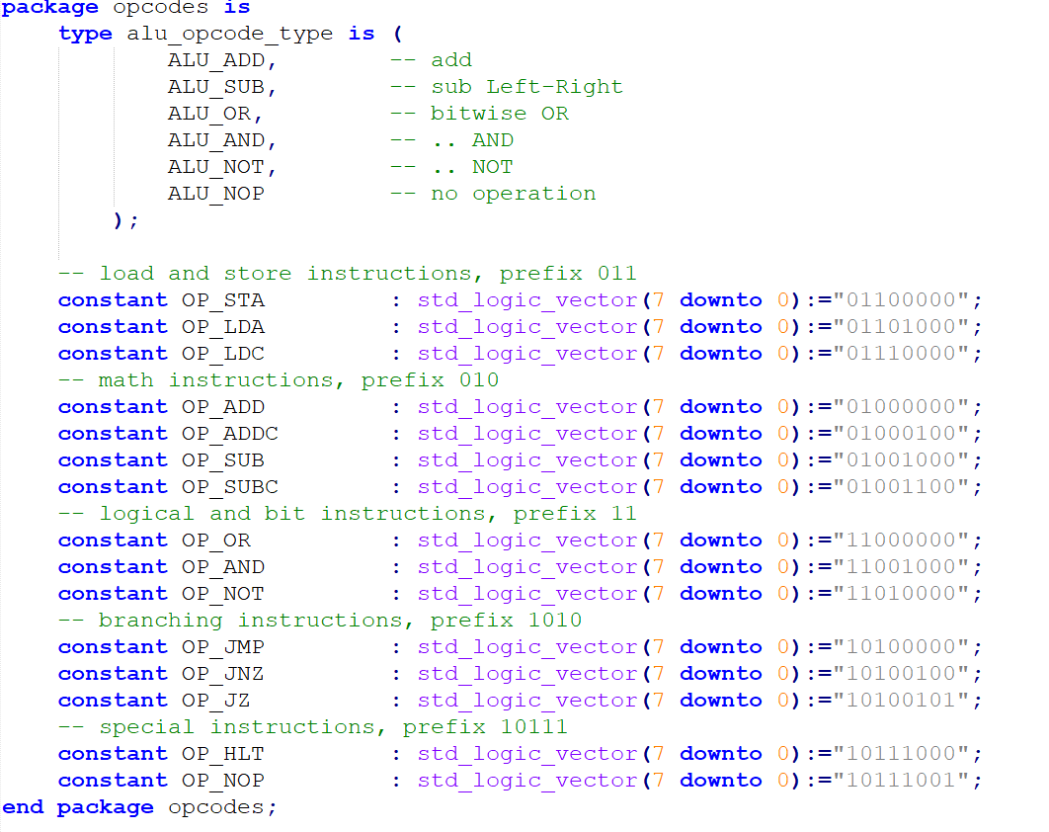
opcodes.vhd

Slide 98
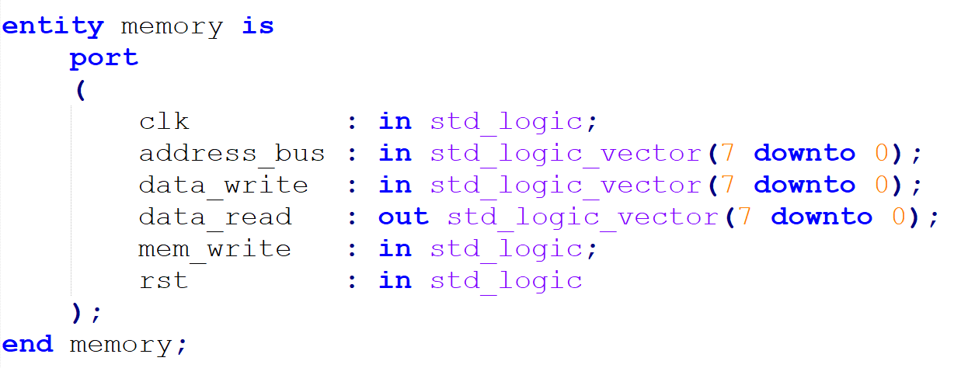
RAM – memory.vhd

Slide 99
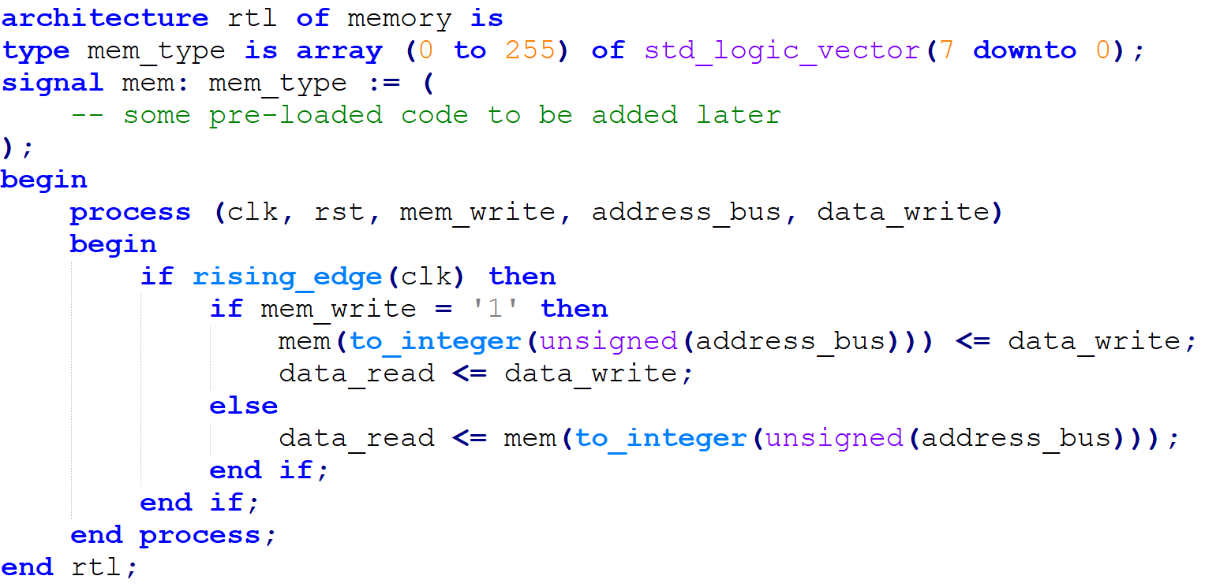
RAM – memory.vhd

Slide 100
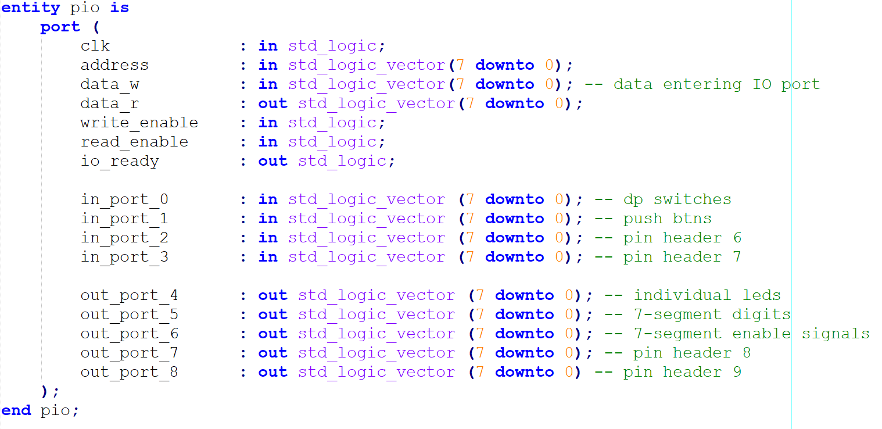
pio.vhd – does nothing in the first cut (just a stub)

Slide 101
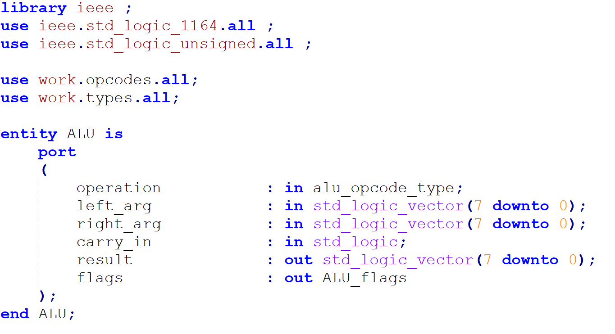
alu.vhd – getting closer…

Slide 102
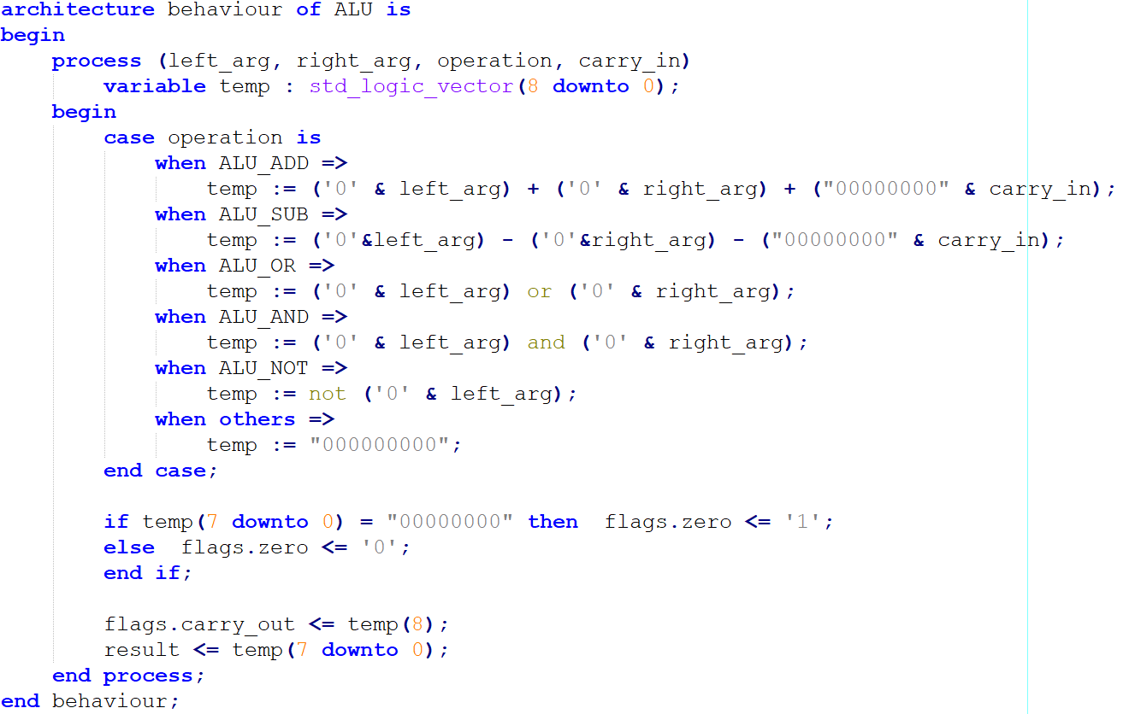
alu.vhd – architecture

Slide 103
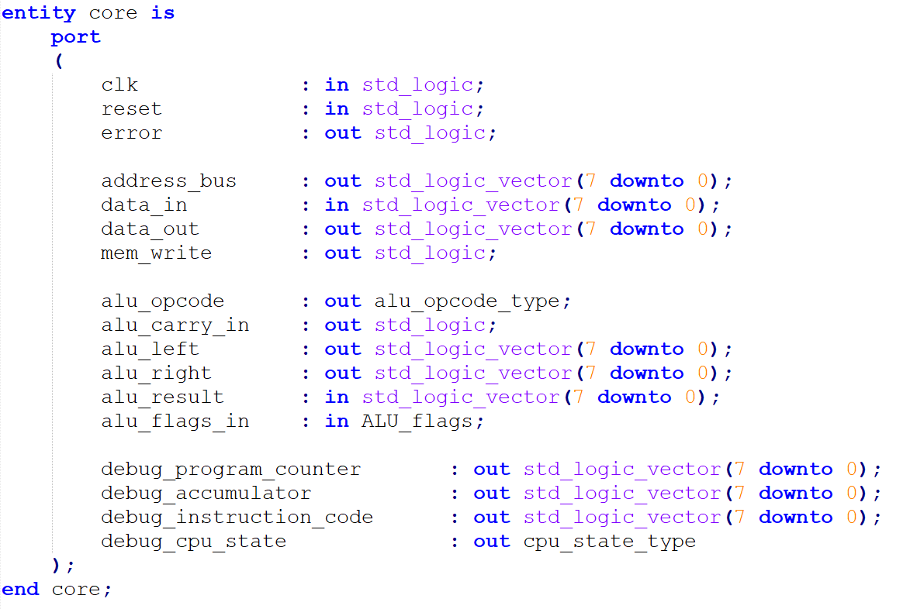
core.vhd – the control unit with registers

Slide 104
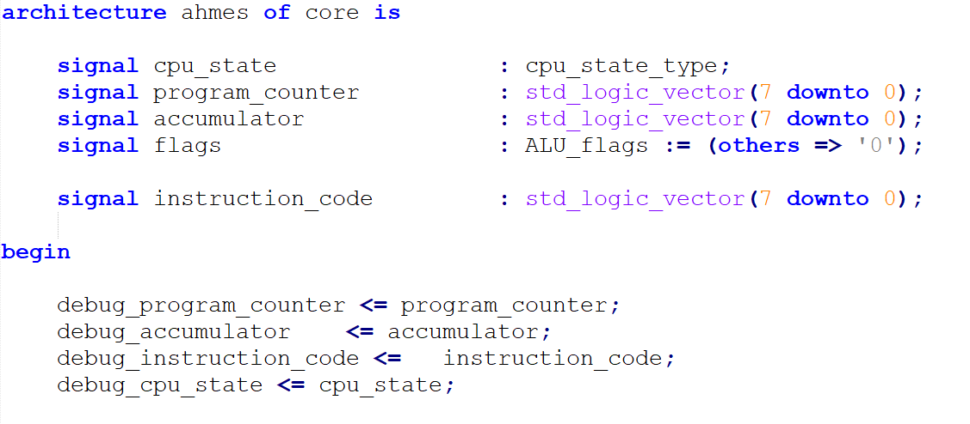
core.vhd

Slide 105
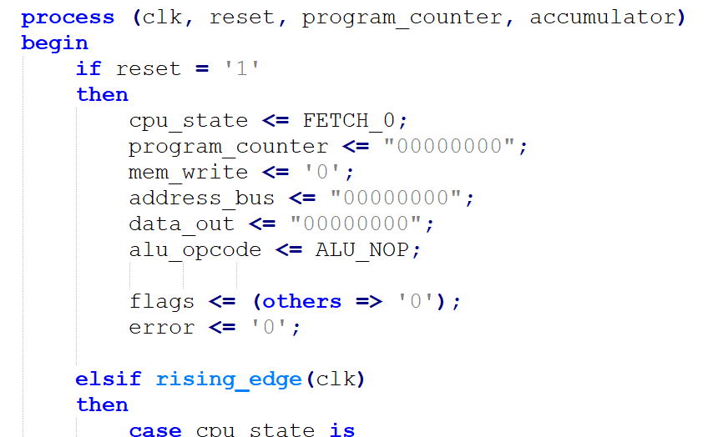
core.vhd

Slide 106
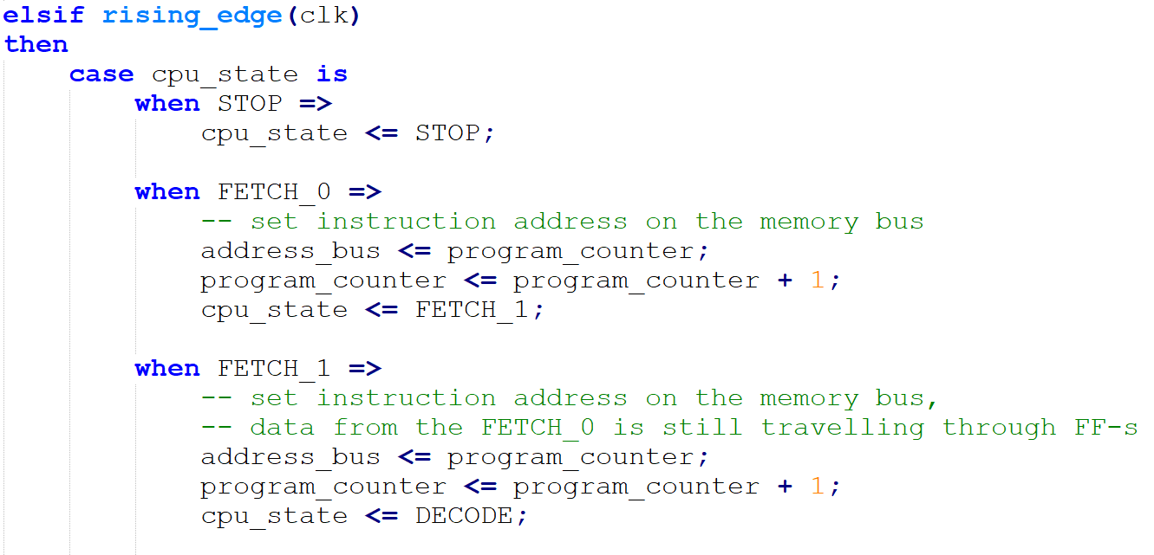
core.vhd

Slide 107
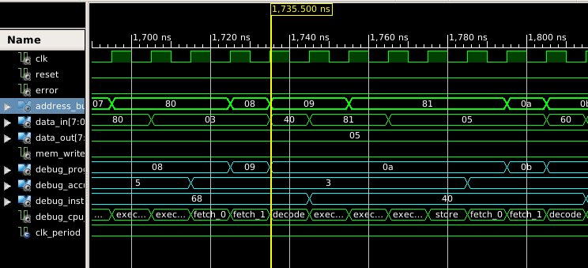
RAM access sequence
The moment “FETCH_1 =>” block result is applied:
Address bus set to ‘9’
PC incremented by 1, now 9 (0xa)
Data requested at ‘FETCH_0’ (addr 8) arrives on the data bus (only usable on the next clk cycle)
The moment “FETCH_0=>” block is result is applied:
Address bus set to ‘8’ (PC)
PC incremented by 1, now 9
The moment “DECODE =>” block result is applied:
Data requested at ‘FETCH_1’ (addr 9) arrives on the data bus (usable on the next clk cycle)

Slide 108
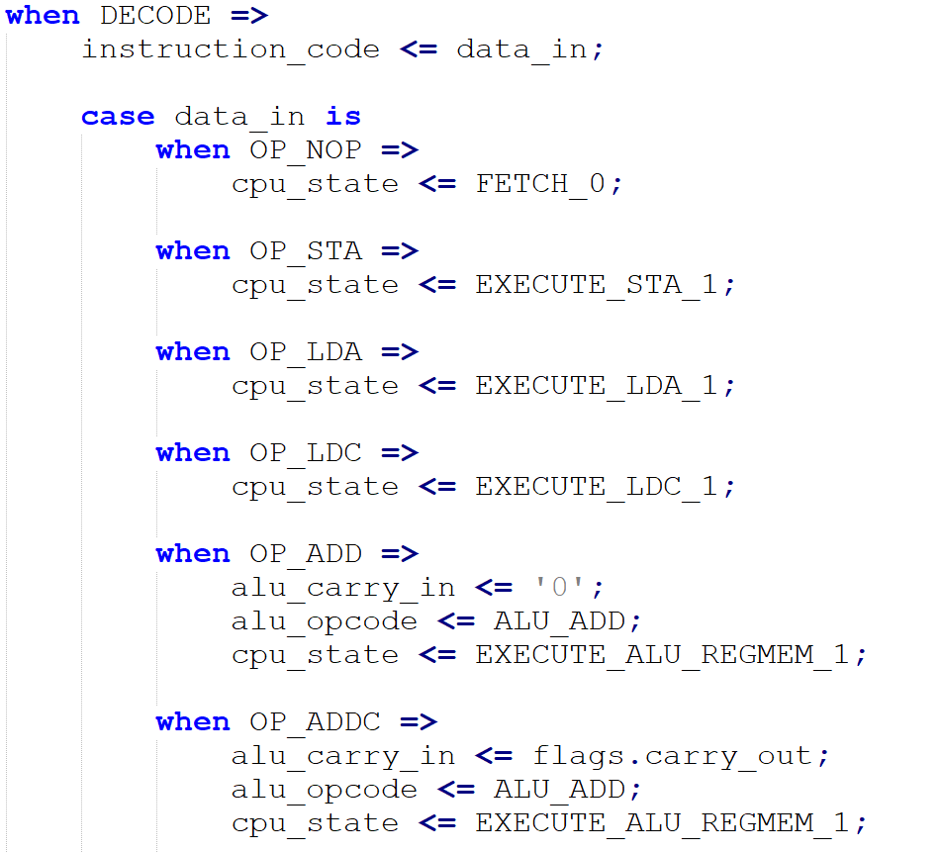
core.vhd
NOTE:
This code would generate Mealy FSM, since outputs - control selectors for various signals depend on both current state (DECODE) and current FSM input (data_in).
This should be OK though, as all inputs are internal for our circuit and data_in is synchronized to the same clock.

Slide 109
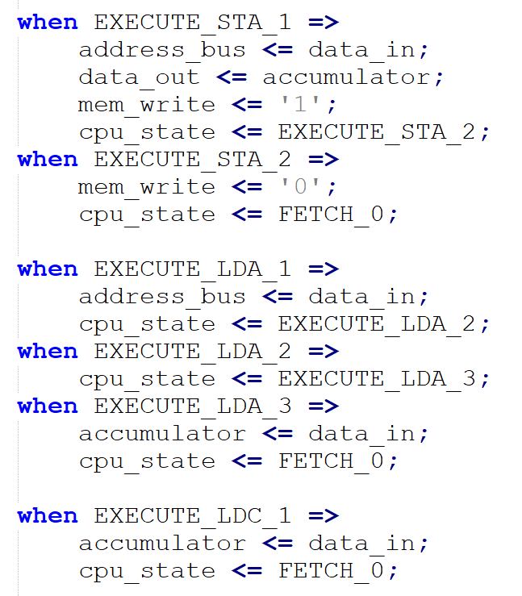
core.vhd

Slide 110
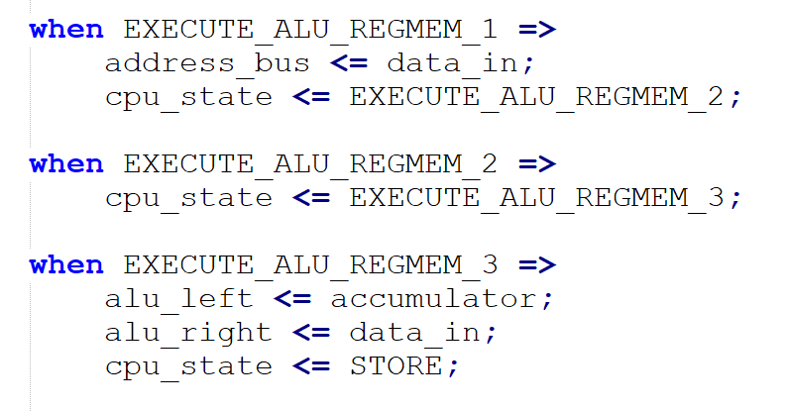
core.vhd

Slide 111
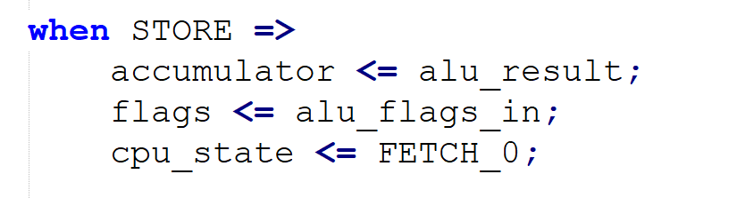
core.vhd

Slide 112
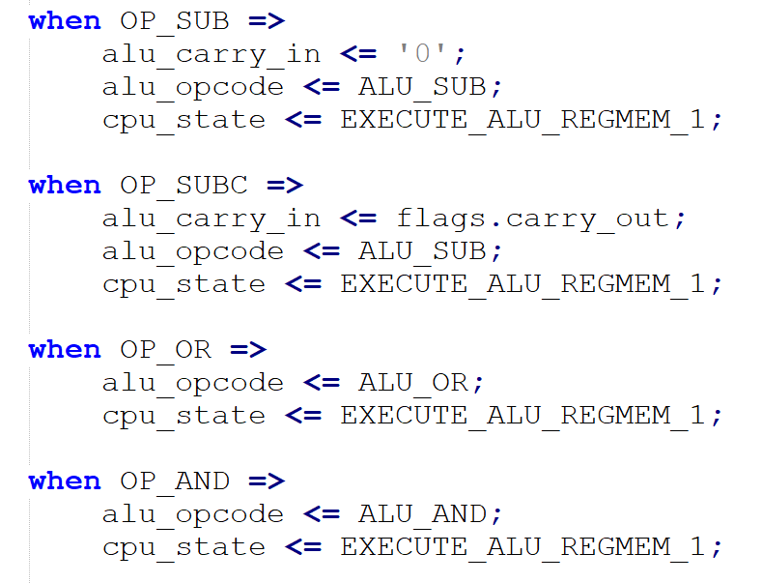
core.vhd
Back to ‘DECODE’:

Slide 113
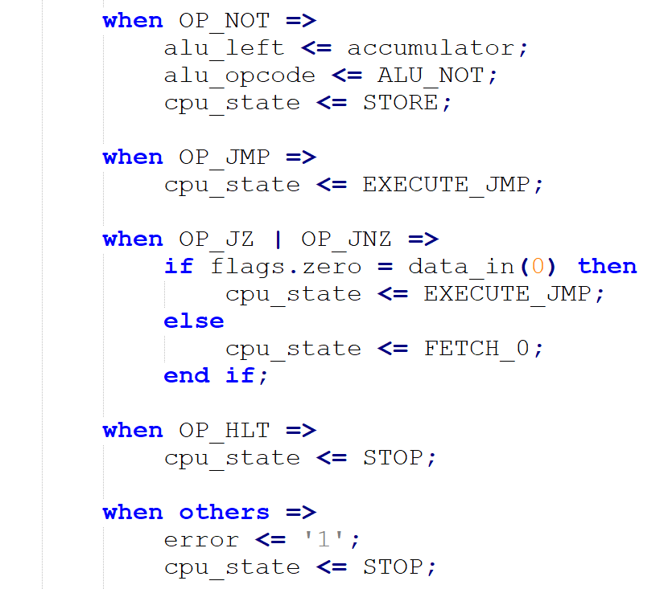
core.vhd

Slide 114
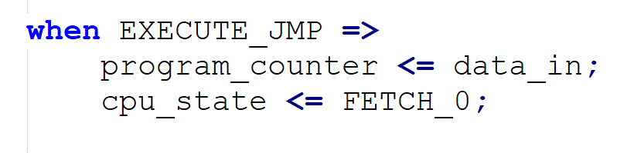
core.vhd
Finally, the last bit

Slide 115
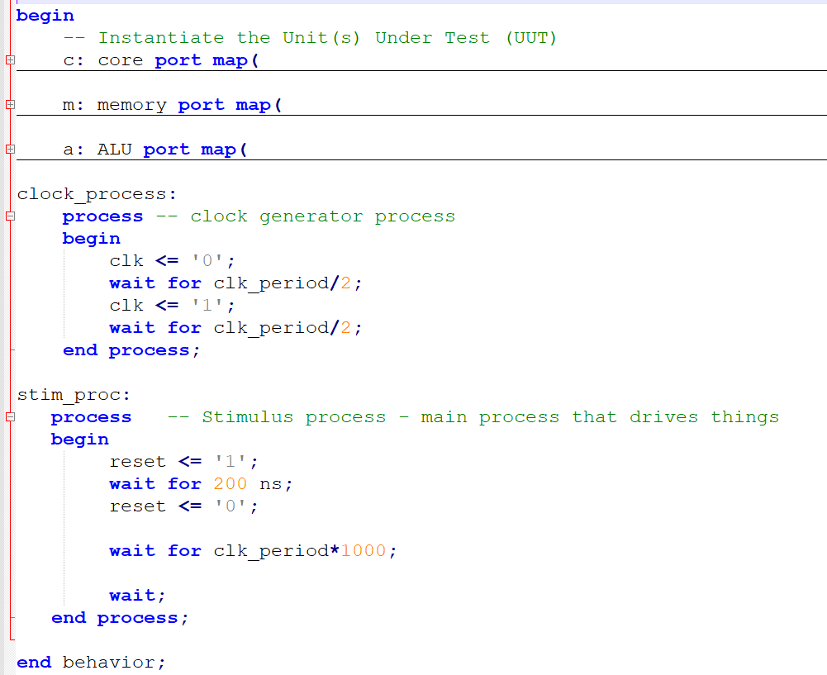
TB_core.vhd – let’s test it
Nothing really there, we just create and link components, drive the clock signal and let the CPU run the code from the memory block

Slide 116

RAM – memory.vhd – preloaded code

Slide 117

TB_core.vhd – simulation run

Slide 118

TB_core.vhd – simulation run – zoom in

Slide 119
Can we do it without *HDL?
Se vi ege volas, vi povas. (Sed vi ne devus).

Slide 120
State | Next State |  |  |  |  |  |  |  |  |  |  |  |  |  |  |  |  | Outputs
 | OP: NOP | OP: STA | OP: LDA | OP: LDC | OP: ADD | OP: ADDC | OP: SUB | OP: SUBC | OP: OR | OP: AND | OP: NOT | OP: JMP | OP: JZ & Z=1 | OP: JZ & Z=0 | OP: JNZ & Z=1 | OP: JNZ & Z=0 | OP:HLT | ALU operation | Carry out | ALU left select | ALU right select | Addr select | Data out select | Mem write select | PC select | Accum select | Flags select
FETCH_0 | FETCH_1
FETCH_1 | DECODE
DECODE
E_STA_1
E_STA_2
E_LDA_1
E_LDA_2
E_LDA_3
E_LDC_1
E_ALU_RM_1
E_ALU_RM_2
E_ALU_RM_3
E_JMP
STORE
STOP
GOOD LUCK! ☺

Slide 121
Let’s look at the rest of the code

Slide 122

types.vhd

Slide 123

types.vhd

Slide 124

opcodes.vhd

Slide 125

opcodes.vhd

Slide 126

opcodes.vhd

Slide 127

opcodes.vhd

Slide 128


core.vhd – remaining bits

Slide 129

core.vhd – remaining bits

Slide 130


core.vhd – remaining bits

Slide 131



core.vhd – remaining bits

Slide 132


core.vhd – remaining bits

Slide 133

core.vhd – remaining bits

Slide 134


alu.vhd – remaining bits

Slide 135

alu.vhd – remaining bits

Slide 136

memory.vhd – now with read_enable

Slide 137

pio.vhd

Slide 138

pio.vhd

Slide 139

pio.vhd

Slide 140

sevenseg.vhd

Slide 141

sevenseg.vhd
Image © 2018 Numato Systems Pvt. Ltd.,
source: https://numato.com/docs/mimas-v2-spartan-6-fpga-development-board-with-ddr-sdram/

Slide 142

sevenseg.vhd

Slide 143

sevenseg.vhd

Slide 144

sevenseg.vhd

Slide 145


soc.vhd – simply linking everything together
It is boring…

Slide 146
Program…

Slide 147



Slide 148

Expected result?
002 003 005 008 00D 015 022 037 059 090 0E9 179 262 3DB 63D A18 055

Slide 149
Finally…

Slide 150


Slide 151

https://www.youtube.com/watch?v=5bxFFdIgmH0

Slide 152
What I didn’t tell you?
Pure lack of time! No conspiracy here

Slide 153
Items not covered
Timing
Flip-Flop timings
Whole design timing calculation / etc
Multiplier and Divider circuits
Clock domain crossing
Workflow of FPGA design (synthesis is only the first step)
IP components / libraries
User constraints
Advanced topics on the CPU design – microcode, pipeline, out of order execution, etc – I’m about to cover it myself yet.
And a lot more… can’t fit everything into our format

Slide 154

Appendix A. Xilinx Spartan 6 family summary
© Xilinx, Source: https://www.xilinx.com/support/documentation/user_guides/ug384.pdf

Slide 155

Appendix B. Xilinx Virtex Ultrascale family summary
© Xilinx, Source: https://www.xilinx.com/support/documentation/data_sheets/ds890-ultrascale-overview.pdf

Slide 156
Appendix C. Further reading
http://www.simplecpudesign.com/simple_cpu_v1/index.html
https://blog.classycode.com/implementing-a-cpu-in-vhdl-part-1-6afd4c1ed491
http://embeddedsystems.io/ahmes-a-simple-8-bit-cpu-in-vhdl/
Plus all the books and materials from part 1!

Slide 157
Appendix D. Mimas V2 Dev Board
https://numato.com/product/mimas-v2-spartan-6-fpga-development-board-with-ddr-sdram

